Slide 1
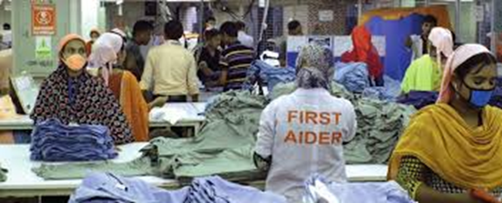
Managers & Supervisors Introduction to Occupational Health & Safety (OHS) Online Course
Welcome
Notes:
Have this slide on screen while waiting for trainees to assemble.

Slide 2
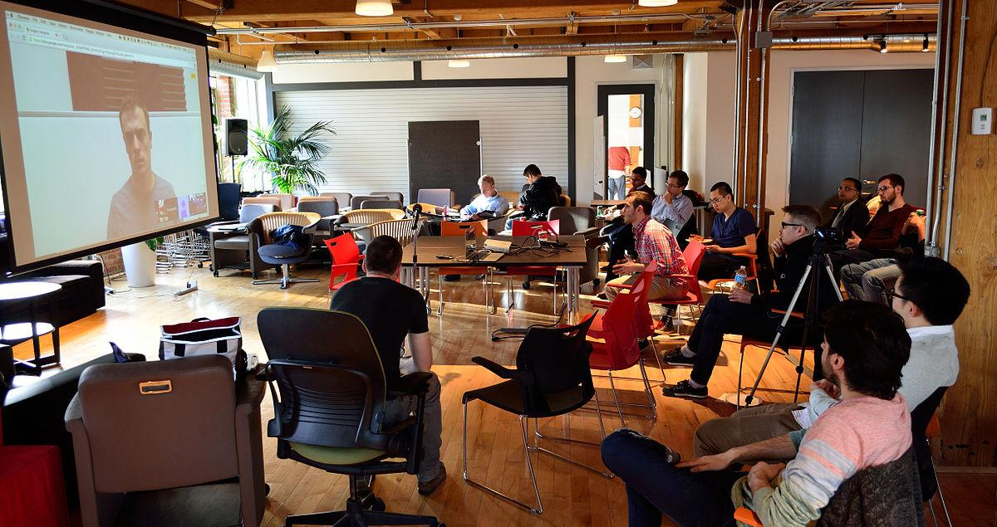
Welcome to your online course
Registration & Administration
Housekeeping
Google meet protocols, hints & tips
Check the microphone/mute, camera & chat functions now.
Course guidelines – agreeing how we’ll learn together: - switch off mobile phones - getting involved, making interventions, Q&A etc. - respect opinions & each other…
This Photo by Unknown Author is licensed under CC BY-SA
Notes:
Welcome participants. Explain that you will start by running through registration, housekeeping and arrangements for the course
Provide brief overview of how zoom/Google Meet/MS Teams work. (If being delivered over Zoom see resource available for Trainers).
Explain Chat function & Breakout Rooms
Highlight Trainer-Trainee learning agreement: Ask them to: Listen what others have to say & avoid being dismissive of their contribution. Wait until a speaker has finished and try not to interrupt. Do not use language that will not offend others. Please stick to the agreed starting and finishing times. If you use “jargon” explain what it means. We can add a jargon sheet to the course pack later if this would be of assistance.
Check everyone is OK with arrangements.

Slide 3
COVID-19 UPDATE
INTRODUCTION TO OHS: MODULE 1

Slide 4
Notes:
Briefly, highlight what we’ll be covering on the course no more than 1-miute.
Identify linked nature of various modules and ‘blended learning’ approach to delivery which will include Tutor presentation; group work; online discussions; use of handouts; films & on/off course activities.
Information provided on the course is sources from sources such as the ILO (International Labour Organisation); WHO (World Health Organisation); and OHS Practioner's in Bangladesh, UK & elsewhere.

Slide 5
ACTIVITY 1: AIMS & OBJECTIVES / KNOWLEDGE & SKILLS
Consider the questions below. Using the ‘chat’ function (or by indicating on screen that you would like to speak), briefly contribute to an online course discussion.
What do you hope to gain from the course?
As a Manager/Supervisor, what knowledge or skills do you need to improve to make a more effective contribution to OHS at your workplace?
What are the key OHS & Covid-19 challenges at your workplace?
Notes:
Trainer to decide whether to split class in to ‘virtual’ breakout rooms or conduct a ‘live’ discussion exploring the questions on the screen. (Preference would be open class discussion).
It would be useful to capture the groups answers as this can be used as a quick Training Needs Analysis (TNA) and referred to at the end of the session to see if we have met their aims and learning needs. The feedback generated should also be collated as this can be used to inform in final project reports.
1. Identify that through a ‘blended learning’ approach (a combination of Tutor input; PowerPoint slide presentations; group work activities; films; handouts; and other resources available off-line) we hope to provide information, advice & guidance and develop their knowledge and skills.

Slide 6
AIMS FOR THE DAY
To provide an Occupational Health & Safety (OHS) in the context of Covid-19 pandemic.
To understand the need to introduce, maintain and monitor prevention & precautionary measures in the workplace.
To identify and adopt ‘best practice’ approaches to tackling hazards & risks found in the workplace and improve conditions for workers.
To provide an overview of the methods and tools available to manage OHS.
To explore the roles and responsibilities of Managers & Supervisors in the context of OHS.
To explore in more detail: - Measures to help make workplaces Covid-19 secure - Risk assessment & control measures - Safe systems of work - Policies, procedures & practice
To consider implications for you and your workplace.
Notes:
Briefly (no more than 2 minutes) highlight aims & objectives. Note where these link with what trainees said in connection with Slide 5.
Note we can’t cover everything on course, so resources are available both as handouts and electronically – identify website link & add this as next slide.
Today, course will cover an ‘Introduction to OHS’ and only an outline of topic areas – more information in handout and by following links to useful websites provided.

Slide 7
Activity 2: What is Occupational Health & safety? (Discussion)
What is health & Safety?
What do you understand by the term ‘accident’?
…an unfortunate incident that happens unexpectedly and unintentionally, typically resulting in damage or injury.
…an event that happens by chance or that is without apparent or deliberate cause.
The social/cultural environment in the workplace allows for faults (e.g. failing to clear away obstructions) to be tolerated. - faults lead to hazards - hazards to risks & accidents - the results of accidents = unintended injury or loss.
So, why should we be training Managers and Supervisors?
Notes:
This activity is about exploring different concepts, perspectives and understanding.
Note different ideas. A common consensus is often that H&S has to do with accident prevention.
Have there been any accidents in the factory? What types? Why did they occur? (Discuss different types of accidents. Reference immediate personal injury; but it doesn’t always need to be an accident that causes injury or ill-health. It could be back problems caused by repeated lifting; repetitive strain injuries or muscular-skeletal disorders due to repetitive work or poor ergonomics. Ask if they see long-term injuries as deliberate or ‘accidental’? Remember, there is no fundamental difference between exposure to a chemical with immediate effects and one where the effects are delayed – perhaps for many years – both are a result of exposure.
Ask trainees to think about the everyday actions they take – seatbelts in the car; PPE in sports, measures around fire in the home etc. As we shall see later, there is a relationship between incidents & accidents and we need to be proactive about H&S rather than just reacting to accidents or causes of ill-health.

Slide 8
Why your role and training are important in terms of OHS & Covid-19
Managers & Supervisors need to create a social environment and culture that encourages personal and collective responsibility and actively reduces hazards and prevent accidents.
Organisations with a positive health and safety culture are characterised by communications founded on mutual trust, by shared perceptions of the importance of health and safety and by confidence in the effectiveness of preventative measures.
OHS training can:
Improve your knowledge, skills and competence.
Have a effect on safety awareness & risk perception.
Help improve OHS culture and communications.
Help reduce the rate of incidents, accidents, injuries & loss.
Help reduce the potential spread of Covid-19 in the workplace.
Help improve worker trust, confidence & security.
Help the company meet its legal obligations.
Have a positive effect on productivity & quality
Help ensure that workers return home safe & healthy to their families.
Notes:
Self-explanatory slide.
Briefly, read out first 2 boxes but only highlight 3 of the last (Blue box). Emphasise Managers & Supervisors role is critical in terms of leadership (they are role models) and so behaviour important; communications; worker consultation and standards-setting etc.
It will help benefit course if they can share their knowledge & experience.

Slide 9
ACTIVITY 3: QUICK QUIZ - KNOWLEDGE CHECK
Before we go any further, let’s quickly check your knowledge about some OHS topics at your work place. Make a note of your answers to the following questions.
Name two First-Aiders in your section/department
To whom should you report health & safety problems
Which law covers OHS at the workplace
When did the factory last check its fire evacuation procedures
How many workers representatives are there on the Safety Committee
Where would you find a written statement of the company’s commitment to health & safety
Have you been trained in how to conduct a H&S inspection or accident investigation
Notes:
As Managers & Supervisors you need knowledge and skills to carry out your role. This is activity is just a bit of an ice-breaker to test the local knowledge of trainees (more so Supervisors). Trainees should know the answers to most of the questions. If they don’t know the answers to Q: 1, 2, 4, 5, & 6 their peers or Managers should be able to tell them or they should find out immediately after the course.
Q3: Mainly covered by The Bangladesh Employment Act 2006 (Especially Chapters 5- Ch8). Amended Bangladesh Labour (Amendment) Act, 2013 (Act No. 30 of 2013). There are a number of other laws and regulations which also have some provisions related to occupational health and safety and also see other specialist legislation e.g Mines & Docks.
Q7 – if they have been trained great! If not, why not and do they think they should be trained? If they don’t carry out Insp/Acc Investigation then who does?
Stress that their knowledge, opinions and attitude towards H&S are important because if we don’t adopt the right approach the outcomes can be tragic for all involved. For example, reflect on these figures below make following points:
DEATHS
In Bangladesh, nearly 1,000 people every year are killed at work.
WORK-RELATED NJURIES & DISEASES
Hundreds of thousands of others, die prematurely as a result of work-related injuries and long-term industrial illness/diseases.
EXCEPTIONAL CIRCUMSTANCES? It will never happen to me!
It is important not to think of death, injury and ill health statistics as just figures – these numbers are real people. They don’t happen in highly unusual or exceptional circumstances, they happen everyday to people like you and your work colleagues and in workplaces across Bangladesh. Have there been any accidents in your workplace? If so, what were the main causes?
By improving OHS standards, many of these incidents can be avoided.
Also refer to resource: MANAGING HEALTH & SAFETY IN THE WORKPLACE (Department of Inspections for Factories and Establishments (DIFE) Ministry of Labour and Employment)
https://dife.portal.gov.bd/sites/default/files/files/dife.portal.gov.bd/publications/00084045_2bb2_4159_861b_1cc488c45881/5%20Managing%20Health%20and%20Safety%20in%20the%20work%20place_%20English%20V9.pdf
Inset Bangla link here:

Slide 10
ACTIVITY 4: UNDERSTANDING COVID-19
GROUP WORK In small groups, discuss the questions below. Elect a spokesperson to report back your answers to the whole course.
Is COVID-19 an OSH issue? (Please explain why you reached your conclusion?)
How can Covid-19 be transmitted? (Give some examples).
Briefly describe your workplace Covid-19 prevention and precautionary measures. Are they fit for purpose and monitored regularly?
Do you have a Covid-19 taskforce at your workplace or does the workplace safety committee deal with CV-19/OHS arrangements?
What do understand by the phrase the ‘risk management process’?

Slide 11
ACTIVITY 2: UNDERSTANDING COVID-19
TUTOR FEEDBACK
Q1: Coronavirus is an occupational hazard, because its a biological agent that might be present at work and has the potential to cause damages to workers’ health
Q2: It can be transmitted: Directly: Through the transfer of respiratory droplets from the infected person to other(s) that are close, released when the infected person coughs, sneezes or speaks; Indirectly: Through contact with materials or equipment at work (e.g. surfaces, tools, work equipment) or hands contaminated with respiratory secretions of an infected person which transfer to the mucous membranes of the mouth, nose or eyes of other(s). Q3: Coronavirus can be introduced into workplace through & between workers, suppliers, clients, visitors, the public and contaminated objects. It can be transmitted: - While travelling to/from work and during work activities; - It can be transmitted out of the workplaces through workers, suppliers, clients, visitors, or contaminated objects.
Q4: Implementation of appropriate OSH management systems at in the workplace can lessen the impact of COVID-19, save lives and ensure businesses can remain open.
Q5: Risk management process…?
Notes:
Although we have lived with the coronavirus pandemic for many months it is timely to remind ourselves about the nature of the virus to avoid our becoming complacent.
A ‘second wave’ is occurring in many parts of the world so we need to be extra vigilant both in the workplace & community.
Ask participants to review their procedures and practice to assess whether arrangements are still adequate and all workers and visitors are following precautions.

Slide 12
The risk assessment process
Although the concrete preventive and protective measures aimed at eliminating or reducing the occupational risk of coronavirus contagion depend the nature of the virus. --------------- The ‘risk management process’ itself relates to:
Step: 1 | Identifying the hazards.
Step: 2 | Deciding who might be harmed and how.
Step: 3 | Evaluating the risks and decide on precautions.
Step: 4 | Recording your findings and implement them.
Step: 5 | Reviewing your risk assessment and update if necessary.
Notes:
The nature of the virus and how it can be spread (its transmission) determine how Covid-19 hazards & risks assessment should be tackled.
As with other physical hazards and risks (such as chemicals, manual handling or repetitive strain injuries) the 5-Steps approach is a useful tool/technique to adopt.
We cover hazards, risks & risk assessments in more depth in the next module.
Check people understand the basic approach. Ask whether people have used this method in their workplace?
Does their risk management process reflect this approach? If not, why not?

Slide 13
OSH & Covid-19 Risks Assessment
Assess all occupational risks to which employees are (or might be) exposed, regarding all work activities, processes, workstations, equipment, substances and products and identify the exposed workers, including:
All the risks to which workers were exposed before COVID-19 outbreak and that still remain. The risk of coronavirus contagion, which level depends on:
Probability of exposure of workers to coronavirus, considering COVID-19 characteristics (i.e., transmission patterns) and of their contact with infectious persons (e.g., colleagues, suppliers, clients, visitors or public) or contaminated environments/materials (waste, work equipment, tools, etc.).
The severity of resulting health outcomes, considering individual factors (age, underlying diseases & health conditions), and measures available to control the impact of the infection.
The risks resulting from the preventive & protective measures against coronavirus contagion (& their interaction), including: psychosocial risks (stress, domestic violence and isolation, associated with teleworking/social distancing); ergonomic risks, and exposure to chemical agents (due to increased use of cleaning/hygiene products).
Notes:
Self-explanatory. Para-phrase for brevity but identify that risk assessments will need to be reviewed more frequently and as circumstances change. Make the Point: The blue slides marked with an ‘I’ are more for reference and act as an off course resource. They provide more details information and Trainers will only pick out key point and will not go through every point. However, let trainees know that if there is any item they wish to raise from these slides please ask them to raise the matter/issue.

Slide 14
Employers Responsibilities
Employers’ main responsibilities:
To take (and continuously adjust to changing circumstances) measures to ensure workers’ OSH in every aspect related to work, with compliance with controls, in particular, avoiding risks/assessing the risks that cannot be avoided;
Ensure that workplaces, machinery, equipment, processes, chemical, physical and biological substances under their control are safe and without risk to workers’ safety and health;
Ensure the organization and functioning of workplace OSH services;
Ensure that workers and their representatives are consulted, informed, and trained on OSH as appropriate
Ensure the surveillance of workers’ health;
Provide workers with adequate PPEs (at no cost to workers);
Provide measures to deal with emergencies & accidents, including 1st Aid arrangements.
Notes:
Self-explanatory.
Do not necessarily go through every item but highlight need for coordination, communication/ planning & policies. Self-explanatory. Para-phrase for brevity but identify that risk assessments will need to be reviewed more frequently and as circumstances change. Make the Point: The blue slides marked with an ‘I’ are more for reference and act as an off course resource. They provide more details information and Trainers will only pick out key point and will not go through every point. However, let trainees know that if there is any item they wish to raise from these slides please ask them to raise the matter/issue.

Slide 15
Occupational Risks Prevention Plan
On the basis of the risk assessment, an Occupational Risks Prevention Plan should be formulated and implemented. This plan should contain, at least, the following information:
Identified Hazards
Risks assessed and their respective risk level
Most appropriate OSH Preventive & protective measures to implement
Timetable and resources needed to implement each measure
Responsible persons for the implementation of each measure
Objectives, indicators and targets regarding the implementation of each measure;
Procedures for monitoring and evaluating implementation of the measures
To control OSH risks (including coronavirus contagion), OSH preventive and protective measures should be implemented to reduce their occurrence probability and the severity of their consequences!
Notes:
Do not necessarily go through every item but highlight need for coordination, communication/ planning & policies. Self-explanatory. Para-phrase for brevity but identify that risk assessments will need to be reviewed more frequently and as circumstances change. Make the Point: The blue slides marked with an ‘I’ are more for reference and act as an off course resource. They provide more details information and Trainers will only pick out key point and will not go through every point. However, let trainees know that if there is any item they wish to raise from these slides please ask them to raise the matter/issue.

Slide 16
Examples of specific OSH Preventive & Protective Measures used to mitigate risk of CV-19 contagion at work (1)
(It is recognised that many of these measures will already being used in factories. These slides summarise recognised good practice).
Physical distancing:
New principles of social conduct: refraining from hugging, kissing or shaking hands.
Re-organise the work in order to ensure physical distancing between people that, otherwise, would interact closely at work (e.g., workers, customers, suppliers, visitor, public), through:
Teleworking/Home working (where possible and appropriate)
Staggered working hours or additional work shifts (with fewer people on each);
Substitution of physical contacts by phone, email or virtual meetings (online) contacts;
Ensure the maximum distance possible between workstations (consider screen or Perspex dividers where possible);
Avoid crowding of people at workplace: cancellation of gatherings, social or sport events; institution of
Staggered access or use of common areas/spaces (e.g., cafeteria, meeting rooms, access & egress from building); and
Institute one-way system for walkways, stairs and entry/exit routes out of areas
Notes:
Do not necessarily go through every item but highlight need for coordination, communication/ planning & policies. Self-explanatory. Para-phrase for brevity but identify that risk assessments will need to be reviewed more frequently and as circumstances change. Make the Point: The blue slides marked with an ‘I’ are more for reference and act as an off course resource. They provide more details information and Trainers will only pick out key point and will not go through every point. However, let trainees know that if there is any item they wish to raise from these slides please ask them to raise the matter/issue.

Slide 17
Examples of specific OSH Preventive & Protective Measures used to mitigate risk of CV-19 contagion at work (2)
(It is recognised that many of these measures will already being used in factories. These slides summarise recognised good practice).
Physical distancing (continued):
Limit the number of persons (workers, clients/public) allowed to be simultaneously in a given space to a fraction of its capacity (e.g., 1/3) or given ratio per sq metre (0,04 per square metre);
Limit the minimum distance between people to a specific number of meters (1 m in open space; 2 m indoor) and put appropriate safety signs in place;
Forbid the presence of public or customers at workplaces and deliver products at the premises door or at customers’ but without the entrance of the worker at the customers’ premises where possible;
Prevent suppliers from entering workplace by receiving orders at entrance;
Implement different circulation paths and pedestrian traffic routes; and
Install physical barriers (glass/acrylic windows, shutters), especially in front-office workstations.
Notes:
Do not necessarily go through every item but highlight need for coordination, communication/ planning & policies. Self-explanatory. Para-phrase for brevity but identify that risk assessments will need to be reviewed more frequently and as circumstances change. Make the Point: The blue slides marked with an ‘I’ are more for reference and act as an off course resource. They provide more details information and Trainers will only pick out key point and will not go through every point. However, let trainees know that if there is any item they wish to raise from these slides please ask them to raise the matter/issue.

Slide 18
Examples of specific OSH Preventive & Protective Measures used to mitigate risk of CV-19 contagion at work (3)
Hygiene:
Promote good respiratory hygiene at the workplace (e.g., covering your mouth and nose with your bent elbow or tissue when you cough or sneeze):
Ensure easily accessible places to wash hands with soap and water and paper towels to dry them;
Provide workers with easily accessible alcohol-based antiseptic solution for hands hygiene;
Promoting a culture of handwashing and the adoption of adequate basic procedures for hands hygiene;
Prohibit eating or drinking in working areas;
Promote the non-sharing between workers of personal, work and domestic items (cell phones, headphones,
PPEs, crockery and kitchen utensils, clothes, uniforms, towels etc.) and food.
Also refer to ‘Toolbox Talk’ & Film resources on Hygiene & Facemasks
Notes:
Do not necessarily go through every item but highlight need for coordination, communication/ planning & policies. Self-explanatory. Para-phrase for brevity but identify that risk assessments will need to be reviewed more frequently and as circumstances change. Make the Point: The blue slides marked with an ‘I’ are more for reference and act as an off course resource. They provide more details information and Trainers will only pick out key point and will not go through every point. However, let trainees know that if there is any item they wish to raise from these slides please ask them to raise the matter/issue.

Slide 19
Examples of specific OSH Preventive & Protective Measures used to mitigate risk of CV-19 contagion at work (4)
Cleaning:
Promote a culture of regularly cleaning, with adequate detergent and/or disinfectant, the following:
Surfaces of desks, telephones and keyboards;
Workstations, work equipment, work tools and PPE (if reusable and appropriate);
Doorknobs, handrail, counters, light switches, lift buttons, vending machines, scissors, dispensers, etc;
Common areas such as toilets, rest rooms, cafeteria, meeting rooms, etc.
Remember to pay attention to the role of factory/contract cleaners - they may be more exposed than other workers/face increased exposure to detergents & chemicals.
Also refer to ‘Toolbox Talk’ & Film resources on Hygiene & Facemasks etc.
Notes:
Do not necessarily go through every item but highlight need for coordination, communication/ planning & policies. Self-explanatory. Para-phrase for brevity but identify that risk assessments will need to be reviewed more frequently and as circumstances change. Make the Point: The blue slides marked with an ‘I’ are more for reference and act as an off course resource. They provide more details information and Trainers will only pick out key point and will not go through every point. However, let trainees know that if there is any item they wish to raise from these slides please ask them to raise the matter/issue.

Slide 20
Examples of specific OSH Preventive & Protective Measures used to mitigate risk of CV-19 contagion at work (5)
Information, training and communication:
(As we are doing on this courses).
Provide information and training to managers, supervisors, workers and their representatives on:
The risks to which they are exposed and the adopted measures to prevent their exposure, in particular, to coronavirus;
Physical distancing measures, principles of social conduct, respiratory hygiene, procedures for hands hygiene and cleaning of premises and material components of work;
How to act in case of Covid-19 infection;
Correct use, maintenance and disposal of facemasks/PPE;
Updates regarding the COVID-19 situation at the workplace, region or country;
Their right to remove themselves from a work situation that poses an imminent and serious danger for life or health.
Also refer to ‘Toolbox Talk’ & Film resources on Hygiene & Facemasks etc.
Notes:
Do not necessarily go through every item but highlight need for coordination, communication/planning & policies. Self-explanatory. Para-phrase for brevity but identify that risk assessments will need to be reviewed more frequently and as circumstances change. Make the Point: The blue slides marked with an ‘I’ are more for reference and act as an off course resource. They provide more details information and Trainers will only pick out key point and will not go through every point. However, let trainees know that if there is any item they wish to raise from these slides please ask them to raise the matter/issue.

Slide 21
Examples of specific OSH Preventive & Protective Measures used to mitigate risk of CV-19 contagion at work (6)
Health surveillance & response mechanisms:
Employers should safeguard the surveillance of workers’ health, according to local health authorities guidelines and, in particular, ensure that:
Workers with suspected symptoms of Covid-19 do not come to the workplace
In case of development of Covid-19 symptoms at the work site: worker should communicate situation to supervisor and move to “isolation area” defined in the factory contingence plan, while awaiting transfer to an appropriate health facility; worker or employer contact health authorities; employer should notify OSH services/occupational physician and adequately disinfect the workplace; provide health surveillance of persons who have been in close contact with the infected worker;
Employers should expand workers’ access to paid sick leave, sickness benefits, and parental/care leave and inform all workers of provisions;
Factories may wish to explore support with government/Brands to help resource such arrangements.
Also refer to ‘Toolbox Talk’ & Film resources on Hygiene & Facemasks etc.
Notes:
Do not necessarily go through every item but highlight need for coordination, communication/planning & policies. Self-explanatory. Para-phrase for brevity but identify that risk assessments will need to be reviewed more frequently and as circumstances change. Make the Point: The blue slides marked with an ‘I’ are more for reference and act as an off course resource. They provide more details information and Trainers will only pick out key point and will not go through every point. However, let trainees know that if there is any item they wish to raise from these slides please ask them to raise the matter/issue.

Slide 22
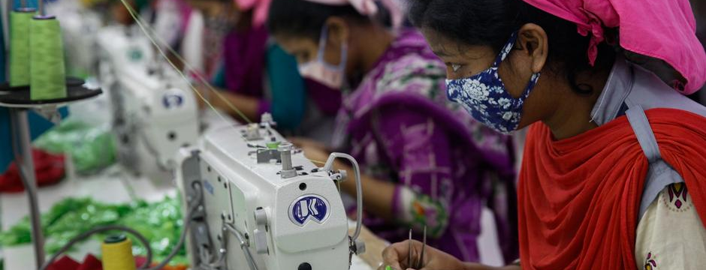
Examples of specific OSH Preventive & Protective Measures used to mitigate risk of CV-19 contagion at work (7)
Personal Protective Equipment (PPE):
Whenever the implementation of other measures is not enough to control the risks, the employer should also, when appropriate:
Provide adequate and free of charge PPEs to workers, taking into account the results of the risk assessment and the eventual need using simultaneously several PPEs;
Provide information and training on the best way to use and maintain the PPE needed and provide instructions about its disposal or re-use if this is appropriate.
Also refer to ‘Toolbox Talk’ & Film resources on Hygiene & Facemasks etc.
Notes:
Do not necessarily go through every item but highlight need for coordination, communication/planning & policies. Self-explanatory. Para-phrase for brevity but identify that risk assessments will need to be reviewed more frequently and as circumstances change. Make the Point: The blue slides marked with an ‘I’ are more for reference and act as an off course resource. They provide more details information and Trainers will only pick out key point and will not go through every point. However, let trainees know that if there is any item they wish to raise from these slides please ask them to raise the matter/issue.

Slide 23
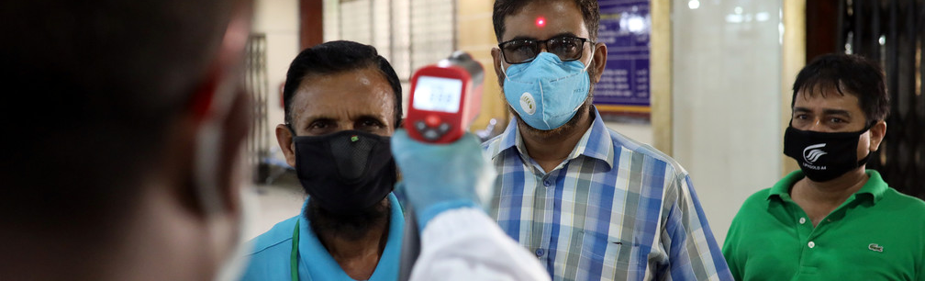
Examples of OSH Preventive & Protective Measures used to mitigate risk of Covid-19 contagion at work Employees Responsibilities (8)
Employees Responsibilities
Take
Take
Co-operate
Use
Do not interfere
Take reasonable care of your own health, safety, hygiene & welfare.
Take reasonable care of the health and safety of others who may be affected by what you do, or do not, do.
Co-operate with your employer’s OHS/Covid-19 policies, procedures, practices as appropriate.
Correctly use work items provided by your employer, including PPE, in accordance with training or instructions
Do not interfere with, or misuse, anything provided for your health, safety or welfare.
Notes:
Do not necessarily go through every item but highlight need for coordination, communication/planning & policies. Self-explanatory. Para-phrase for brevity but identify that risk assessments will need to be reviewed more frequently and as circumstances change. Make the Point: The blue slides marked with an ‘I’ are more for reference and act as an off course resource. They provide more details information and Trainers will only pick out key point and will not go through every point. However, let trainees know that if there is any item they wish to raise from these slides please ask them to raise the matter/issue.

Slide 24
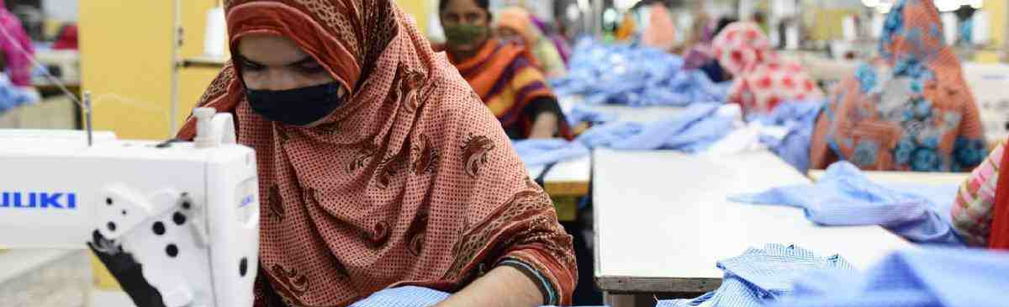
Examples of specific OSH Preventive & Protective Measures used to mitigate risk of CV-19 contagion at work (8)
Conclusions:
Coronavirus is an occupational hazard. The transmission of coronavirus at work is an occupational risk.
Employers have the responsibility to assess the risks resulting from the exposure of workers to coronavirus and to implement the most adequate OSH preventive and protective measures to control it;
The implementation of adequate OSH management systems contributes to reduce the negative impacts of COVID-19 pandemic or of any other type of biological agent (bacterium, fungus or virus) on workers’ health and business continuity.
Review materials provided (off course) and whether you need to amend any of your factory policies, procedures or practices. Further information is available via the resources provided and via the useful website links.
Notes:
Do not necessarily go through every item but highlight/para-phrase for brevity. Make the Point: The blue slides marked with an ‘I’ are more for reference and act as an off course resource. They provide more details and information than we have time to go into today. Trainers let trainees know that if there is any item they wish to raise from these slides please ask them to raise the matter/issue.

Slide 25
