Slide 1
Workplace Health & safety
Introduction to OHS: Module 2
Supervisors & Managers Introduction to Occupational Health & Safety (OHS) Online Course

Slide 2
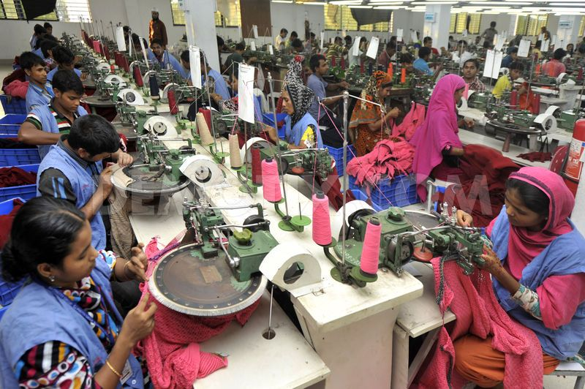
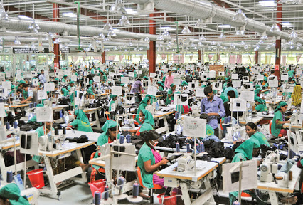
Aims & Objectives Module 2: Workplace Health & Safety
By the end of this session, you should understand:
your role in hazard identification and avoidance and the risk assessment process as a whole;
risk control and the implementation and maintenance of control measures;
the meaning of the terms ‘hazard’ and ‘risk’; and
that the risk assessment process is part of the wider H&S monitoring and review arrangements.
In addition, we will also explore:
understanding responsibilities of workers, supervisors & managers;
how we tackle common hazards in the workplace; and
the use of safety checklists and risk assessments in your workplace.
MO D U L E 2
Functional expert
Knows HR Principles
Customer oriented
Applies business
Manages resources
Strategic partners
Mission oriented
Strategic planner
System Innovator
Understands team behavior
Notes:
Module 1 dealt specifically with aspects of H&S within the context of Covid-19;
Brief introduction to the concept of risk assessment;
Administrative arrangements for H&S, safe systems of work etc;
In this module we are going to explore more about hazards and risks; and develop our understanding about risk perception, the hierarchy of control measures and the integral role risk assessment plays in workplace OHS.

Slide 3
Putting our training in to perspective…
Every day, people die as a result of occupational accidents or work-related diseases – more than 2.78 million deaths world-wide per year.
Every 15 seconds, a worker dies from a work-related accident or disease
Every 15 seconds, 160 workers have a work-related accident There 374 million non-fatal work-related injuries each year, resulting in more than 4 days of absences from work. The human cost is vast and the economic burden of poor OHS practices is estimated at 3.94 % of global Gross Domestic Product (GDP) each year.
Notes:
There is an interesting research piece released in March 2020. See;Israt Parveen, Md. Iqbal Mahmud, Anik Kumar Mondol, Mosammot Nelufa Akter, Shima Shil. A Study on Minimization of Injury and Accidental Causes in Different Operational Sections of RMG Industries in Bangladesh. International Journal of Industrial and Manufacturing Systems Engineering. Vol. 4, No. 1, 2019, pp. 10-18. doi: 10.11648/j.ijimse.20190401.13

Slide 4
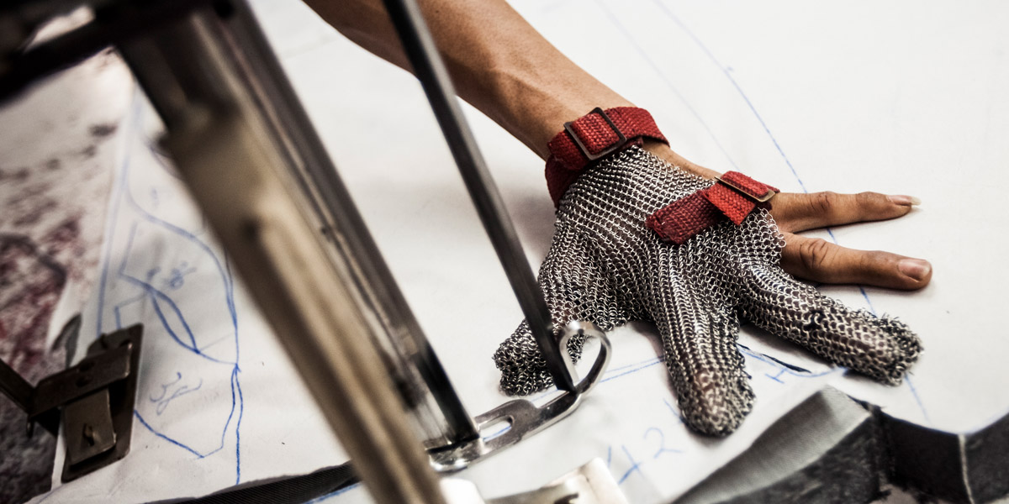
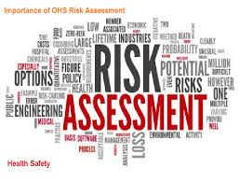
Activity 1: Identifying workplace hazards
Working in pairs or small groups, answer the questions below. (List the hazards and be prepared to report these back to the whole group). You have 10 minutes to complete this task.
Can you give a definition of what a hazard is and can you give examples of hazards you encounter every day
Can you list any hazards in your section/department/workplace
Are new starters told about the kind of hazards that exist in the workplace at their induction
Notes:
This is just a quick activity to find out whether trainees can explain what a ‘hazard’ is and list the types of hazards that may currently exist in the workplace. They also encounter hazards in the home & travelling to work everyday.
Capture their responses on a whiteboard or flipchart and ask them to list the hazards on a flipchart and send you a photograph of the flipchart with their mobile phone. They are likely to report ‘physical’ hazards such as: - obstructed gangways or defective or slippy floors; - Needles from sewing machines; lifting/handling and hazardous chemicals.
If you deliver this activity as a ‘live’ online discussion, if necessary, prompt the trainees to suggest ‘health hazards’ such as: - high noise levels; harmful dust or fumes/vapours; - and other workplace environmental factors that may affect workers such as poor lighting, temperature or bullying and harassment.
Emphasise the importance of stress and repetitive movement – work-related stress is becoming a major issue in many organisations. Repetitive strain injuries or Work-related upper limb disorders (WRULD) can occur as a result of repeated minor movements can result in permanent disability or MSD’s - muscular-skeletal Disorders. Also distinction between hazards & ill-health. E.g back strain is not a hazard it is an injury the hazard which causes it is manual handling.

Slide 5
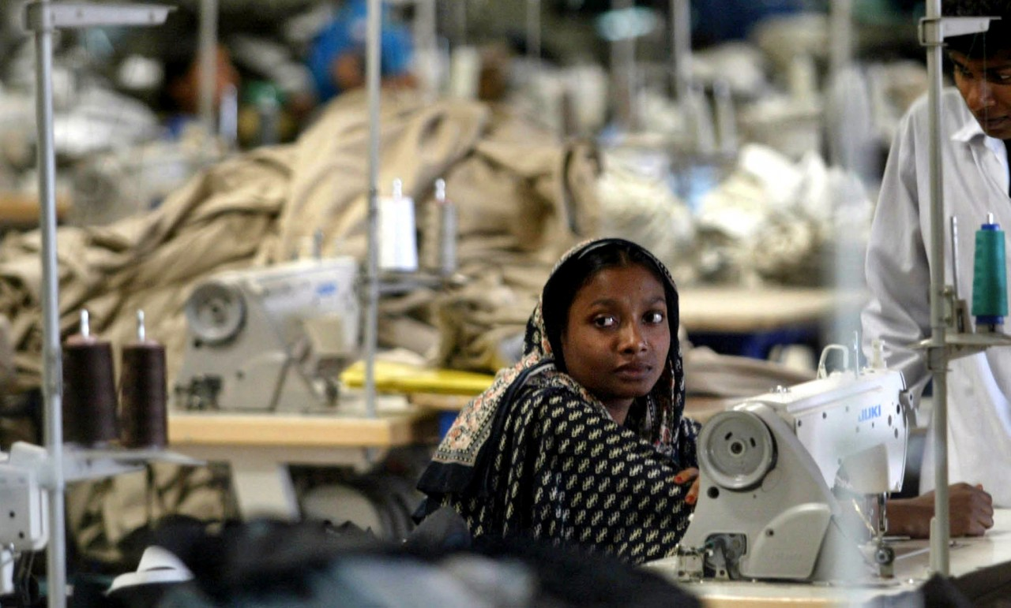
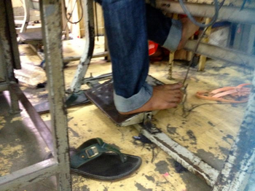
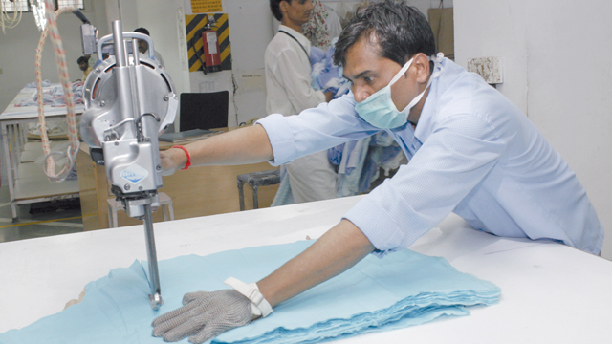
Some risks are more obvious than others!
Can you spot any potential hazards?
bing.com
80% of garment workers in Bangladesh have experienced or witnessed sexual violence and harassment at work (Action-aid UK report, 2019)
RSI & WRULD’s hazards are often not as obvious…
(Ergonomics issues are important)
Notes:
Witnessing a colleague sexually assaulted on the factory floor, women abused for not meeting targets and another fired for being pregnant – these are just some of the shocking experiences of violence and harassment garment workers in Bangladesh have shared with ActionAid UK. (10th June 2019) https://actionaid.org/news/2019/80-garment-workers-bangladesh-have-experienced-or-witnessed-sexual-violence-and

Slide 6
Hazards & Risks
Hazard identification is an essential first step in risk assessment process.
Definition: Risk assessment is a systematic process of identifying hazards and evaluating any associated risks within a workplace, then implementing reasonable control measures to remove or reduce them.
Remember definitions of accidents and hazards from last module: - an accident is ‘…an unplanned event that results in loss’ - a hazard is ‘something that has the potential to cause harm’ - a risk is ‘…the likelihood and the severity of a negative occurrence (injury, ill-health, damage, loss) resulting from a hazard.’
Notes:
The need to recognise and identify hazards and potential risks is an essential skill and requirement if Supervisors & Managers are to carry out their roles and duties and protect workers.
However, our perception of hazards and risks can vary depending on our knowledge, understanding, experience, age and attitude. (For example, younger people will often take more risks – especially young men – whereas older more experienced workers may be more ‘risk averse’ as they more readily understand dangers and the implications of taking risks.
This is a commonly accepted definition of the risk assessment process.
Emphasise the link with what was covered in Module 1 when we explored H&S and definitions of accidents. We will cover more about these issue in Module 3.
*Ask the Supervisors: Have they seen the risk assessment for their work areas? Do they think it would be useful to see these documents? (If yes, why? If no, why?) Have they received any training in carrying out risk assessments? Have they been involved in risk assessment activities?

Slide 7
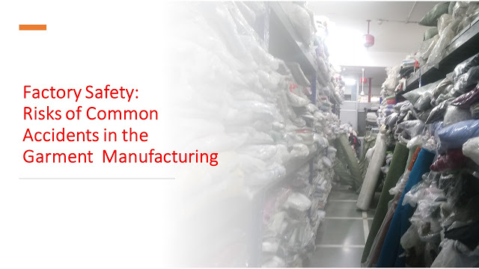
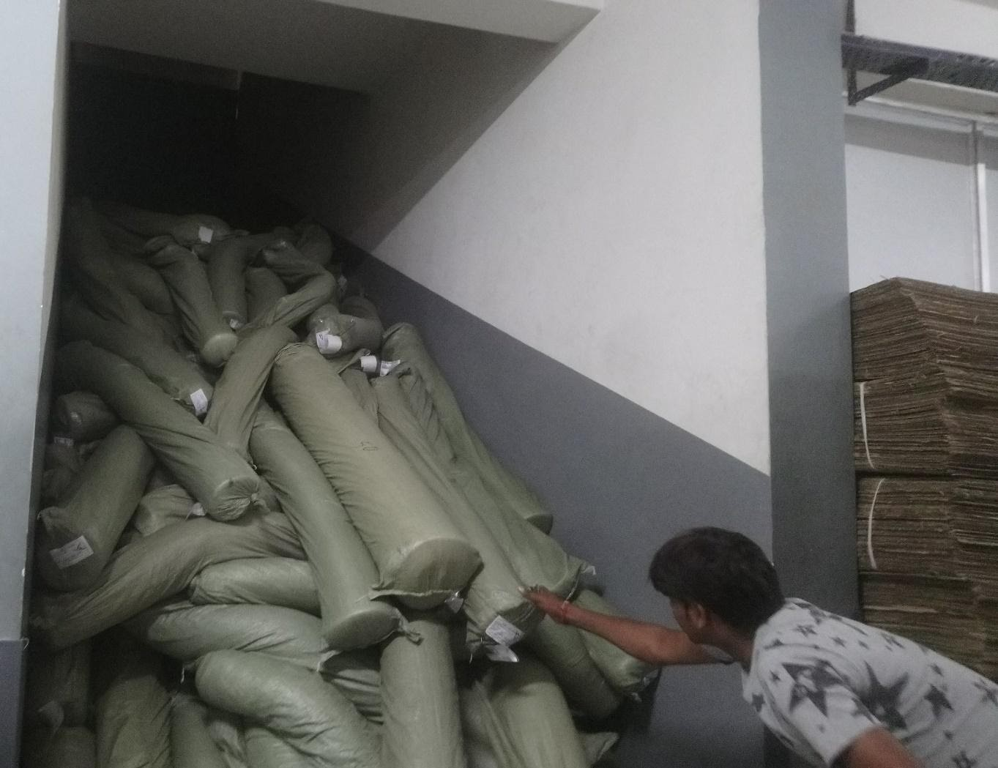
What could possibly go wrong? In the…
1. Cutting Department
Possible accidents in the cutting room may include -
Fatal injury while improper handling of cutting equipment like in straight knife, round knife or band knife. + Electrical shock.
Breathing problem like suffocation in the department due to flying lint.
Improper handling of fabric roll can lead to muscular injury.
2. Warehouse
Possible accidents in the fabric warehouse may include:
Accidental fall while loading/unloading heavy fabric roll, cartons, etc.
Accidental falling of fabric/flat rolls due to rolling/slipping from racks.
Accidental rolling of fabric rolls from ramps often during in-house transport.
Notes:
Source: A recent report ‘Factory Safety: What Could Go Wrong Inside a Garment Export House’. S. Saha, March 13, 2020, highlighted many of the hazards, risks and possible injuries and ill-health complaints that may occur as a result of conditions, exposure or accidents in factories across the garment sector. Run slides 6-10 the as an online/class discussion. Alternatively, if delivered in the classroom trainees could be split in to pairs or small groups to answer the questions. The slides have animation embedded so on the: 1st click - the area of the factory is shown – trainer then asks the group what kind of hazards, risks or accidents could occur in that section of the factory. 2nd click – answers are shown on the slide identifying types of accidents, risks or nature of personal injury that might affect workers.
Continue through slides highlighting that we are applying risk perception – imaging what could hypothetically go wrong based on previous incidents, knowledge of inherent dangers or risks etc. Some situations would likely have an immediate affect if an accident occurred as perceived other situations may result in health implications that develop over a longer period of time. E.g. WRULDs, MSD, RSI or diseases. WRULDs (Work-Related Upper Limb Disorders); MSDs (Musculoskeletal Disorders) and RSI (Repetitive Strain Injury).

Slide 8
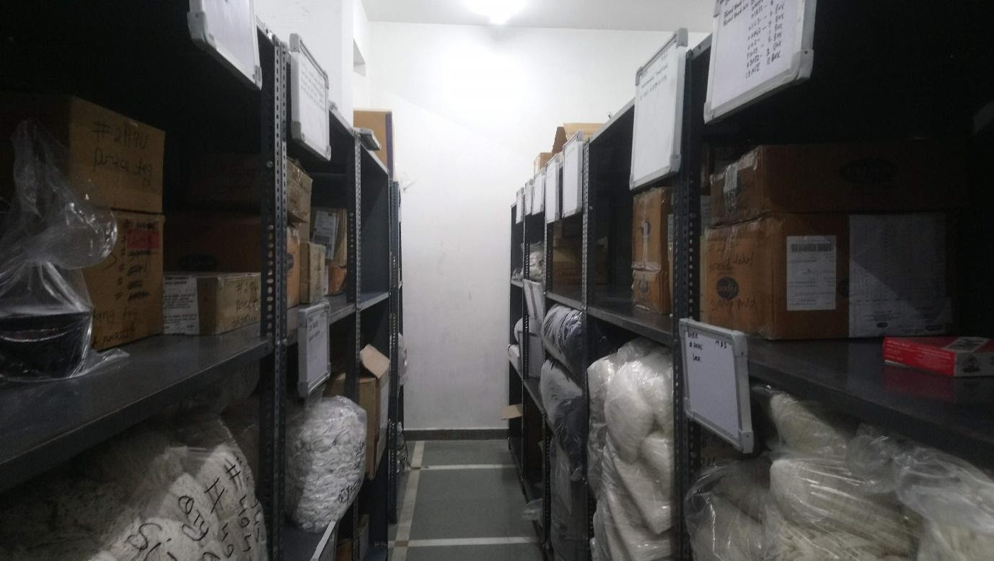
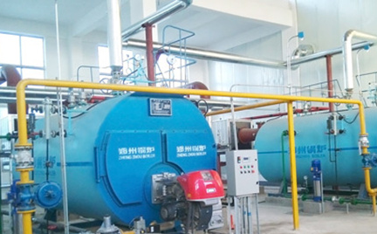
What could possibly go wrong? In the…
3. Maintenance store
Possible accidents in the maintenance store may include:
Accidental falling of tools & equipment.
Injury from mishandling of tools & equipment.
Injury from manual handling/moving heavy equipment (MSD/back-pain etc).
4. Generator area
Possible accidents in the Diesel generator area may include:
This area is more prone to fire due to the presence of fuels.
Health risks of the persons working mostly from fuels, fumes & smoke. (Requires proper Mechanical Exhaust Ventilation)
Heat stroke/dehydration/Noise
Notes:
Trainer continues to progress through slides as directed in slide 6 note.
MSD’s = Muscular Skeletal Disorders WRULDs = Work-related Upper Limb Disorders. Both these conditions can be developed usually over a long period of time (although some back injuries can be brought about very suddenly if worker s adopt poor lifting or manual handling techniques.
Trainer could ask the group if they have been trained in manual handling techniques? Have the group heard of the phrase ‘kinetic lifting’
For example to good trick is to remember how to lift properly is to: Plan.
Position. - Approach the load evenly, with feet about shoulder-width apart.
Pick. - up the load using your thigh muscles to give you power.
Proceed - carry the load cautiously and safely be aware of the ground & your environment
Place - the load safely on a stable surface bending you knees rather than your back to position the load.
Also the TILE acronym is a useful tip: Task - Individual - Load – Environment.

Slide 9
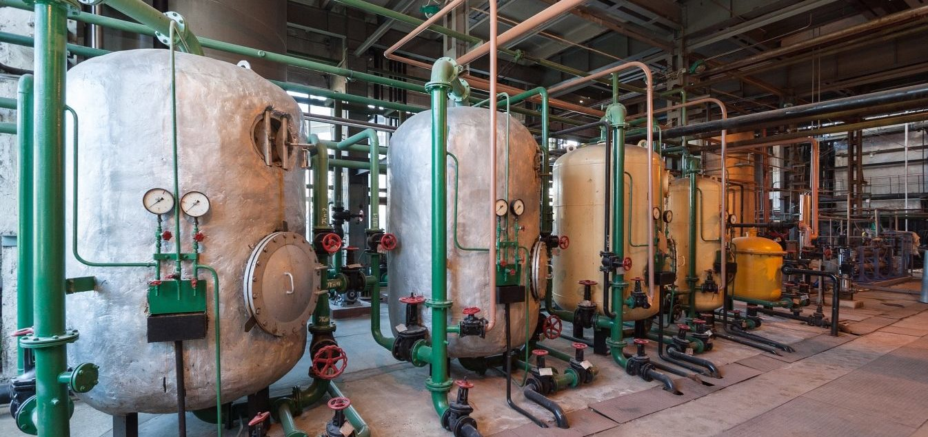
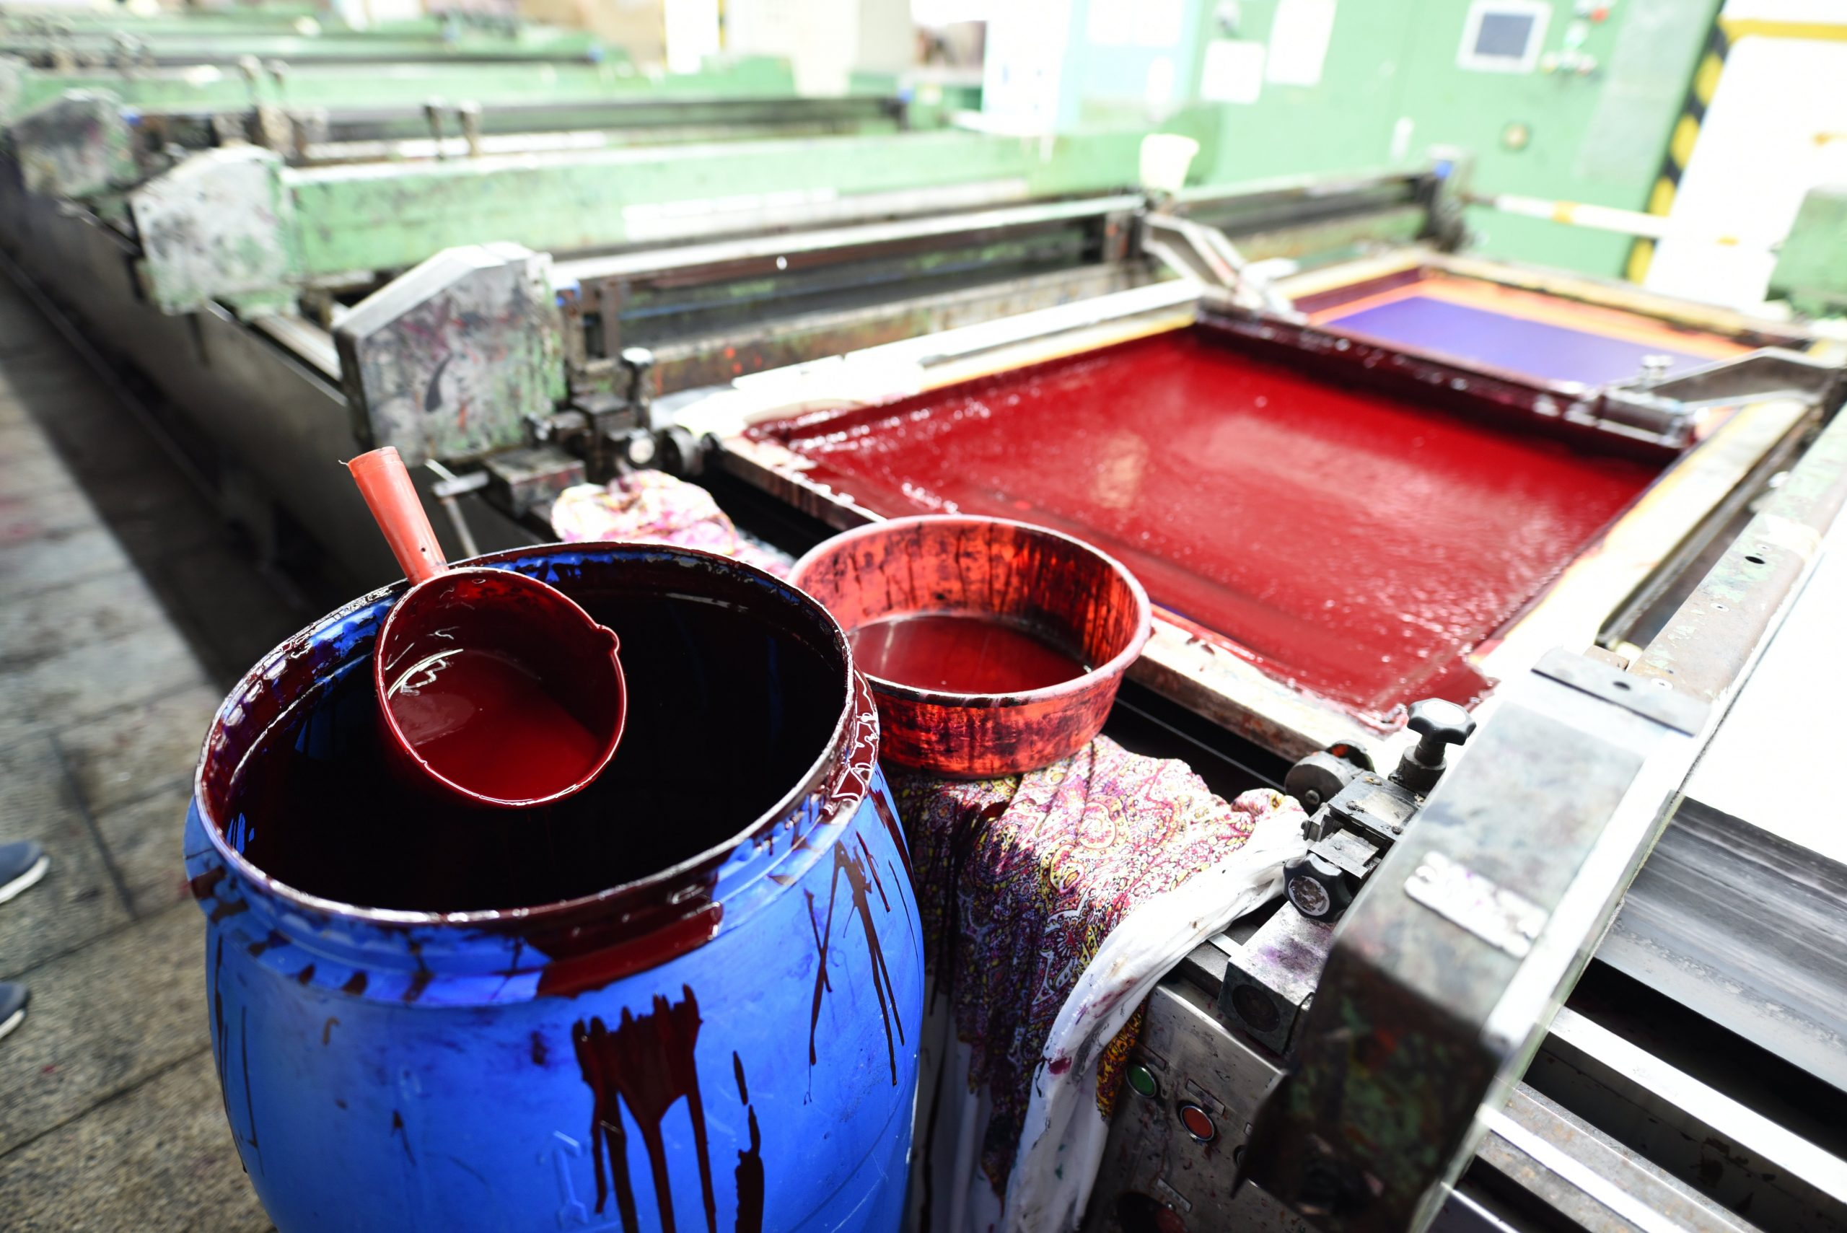
What could possibly go wrong? In the…
5. Boiler area
Possible accidents in the steam generator room (boiler area) may include:
Accidents due to the mishandling of equipment and machinery.
Heat strokes/dehydration.
Health risks of the persons working mostly from fuels and smoke.
Burns/scalds due to sudden steam leakage/accidentally touching boiler.
Bursting of the boiler due to faulty or improper usage.
6. Chemical room/Spot Removing room
Possible accidents in the chemical room may include:
Health risks including weakening of the immune system, development of allergies or asthma, respiratory complaints, reproductive problems, birth defects, mental health issues and skin/dermatitis issues.
This can occur through direct contact or inhaling of toxic fumes.
Notes:
Trainer continues to progress through slides as directed in slide 6 note above.
Trainer to note:
In 2017, according to a news article in the Bangladeshi newspaper The Daily Star only 6 inspectors are assigned to inspect more than 5,000 boilers annually. Additionally, many boilers are poorly maintained and operated by people without proper training. Boiler are one of the main reasons for explosions and fires in garment factories. They can cause building to collapse and even started stampedes of workers in some factories.
Chemicals (and the vapours and fumes they give off) can often be a silent, unseen and deadly killer. They can harm workers immediately or poison them doing long-term damage to organs and the respiratory system. Toxic chemical exposure is also highly dangerous for pregnant women and can impact on the reproductive system.

Slide 10
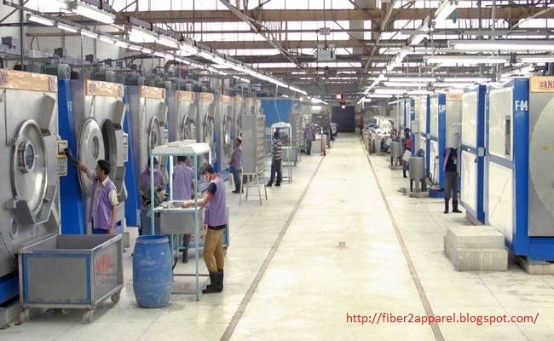
What could possibly go wrong? In the…
7. Production Floor/ Stitching dept
Possible accidents in the stitching floor may include :
Personal injury due to needle breakage, machine usage, needle changing, etc.
Personal injury due to scissors, trimmers/sharp object on the production floor.
Inhaling of lint during stitching on machines like overlock, SNLS with a trimmer.
Noise, Stress, RSI, eye-strain problems, headaches, MSD’s.
The electrical shock from faulty/poorly maintained sewing machines.
Damage to eyes, fingers and hands on needle breakage.
8. Washing Department Possible accidents in the washing department may include:
Risks due to exposure to chemicals used in the washing department.
Slipping due to the wet floor.
Possible electrical shock on wet contact with electrical equipment.
Notes:
Self-explanatory hazards, risks and outcomes.
Trainer should emphasise the range of health issues present on the production floor other than those physical one’s mentioned on the slide. For example, - the levels of stress due to production deadlines and quotas; - bullying, harassment & intimidation of female workers; - constant levels of noise; - poor posture/sitting positions – sedentary work causes poor circulation; stools often with no back support etc.

Slide 11
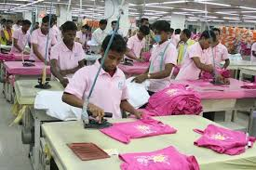
What could possibly go wrong? In the…
9. Finishing Department
Possible accidents in the garment finishing department may include:
Injury due to steam leakage or burns due to ironing/pressing.
Personal injury with mishandling of scissors, trimmers, etc.
Remember! Accidents can cause immediate injuries. Other injuries, diseases & aliments develop over time.
10. Packaging Department Possible accidents in the garment finishing department may include:
Mishandling of cartons during transportation can cause muscle strain and repetitive strain injuries due to constant hand & arm movements.
Paper cuts, injuries from pins, foot, leg and back-pain.
Notes:
Again self-explanatory slide identifying recognisable hazards, risks and outcomes.
Emphasise that time, age, gender, exposure, repetitive movement, stress and the type of job and working environment can affect different workers in various ways.
Work-related Ill-health can have physical and mental implications and result in both short and long term conditions.
Therefore, our approach to risk assessment needs to consider all hazards and risks encountered by workers if we are to properly protect them.
Prevention is better than compensation!

Slide 12
Why OHS training is important ?
Two separate research studies found:
Only 20% of Supervisors report having received any formal training for their jobs & only 5% have received that training outside of the factory. Moreover, while 80% of machine operators are women, fewer than 10% of managers are female.
Most of the respondent (54% workers, Supervisors & Managers) said they did not receive proper training on OHS issues.
Knowledge, understanding and awareness of the risk assessment process should form an integral part of all Supervisors and Managers training.
Notes:
Source: ‘Risks Management of Ready-Made Garments Industry in Bangladesh’ Md. Morshadul Hasan, Appel Mahmud Begum Rokeya University, Rangpur. Cited in International Journal of Business Studies. Vol. 10 | No. 1, 2017.
Akhter, S., Rutherford, S. & Chu, C. Exploring the system capacity to meet occupational health and safety needs: the case of the ready-made garment industry in Bangladesh. BMC Health Serv Res 19, 435 (2019). https://doi.org/10.1186/s12913-019-4291-y
Trainer to emphasise importance of what we are doing today and purpose of the project.
This training could help prevent injuries, the incidence of disease, avert pain and suffering and maybe even save lives!
Training will help improve your knowledge, skills, confidence and ability to carry out your role and responsibilities as a supervisor or manager more effectively.
Spending time and money on your training is not an expenditure it is an investment in a healthy and sustainable future.
Health is the new wealth!

Slide 13
Hazards & risks: What is a risk assessment?
“A risks assessment is simply a careful examination of what, in your workplace, could cause harm to people, so that you can determine whether you have taken enough precautions or should do more to prevent harm” (Worldwide Responsible Accredited Production).
The risk of injury and damage should be controlled to ‘reasonable’ and ‘acceptable’ levels - this is what the risk assessment aims to achieve.
Risk assessment is not an end in itself, but is rather a means of managing risk.
Many managers fail to appreciate this and invest far too much time in developing immaculate documents to keep on a shelf in the hopes of impressing a visiting Inspector, auditor or Director!
A risk assessment is an essential technique to help reduce risks and prevent accidents.
Notes:
Self-explanatory slide.
Risk Assessments should be viewed as ‘live documents’ as they should change, be reviewed and develop as work and circumstances change in the workplace.

Slide 14
Basic principles of risk assessment
Risk assessment should identify all the significant hazards associated with a task and evaluate the risks.
A risk assessment should be:
suitable and sufficient
not a one-off event but an on-going cycle of activity
it must include monitoring & review
it must be planned & thorough
it must be competently executed (ideally by a ‘competent’ person)(?)
it must be a matter of detailed record
it must record all significant findings.
Notes:
Self-explanatory.
Para-phrase for brevity but identify that risk assessments will need to be reviewed more frequently and as circumstances change.
Make the Point: The blue slides marked with an ‘I’ are more for reference and act as an off course resource. They provide more details information and Trainers will only pick out key point and will not go through every point. However, let trainees know that if there is any item they wish to raise from these slides please ask them to raise the matter/issue.
* Ask the trainees if they know who the ‘Competent Person’ is for the factory? Ask them what they think is meant by the phrase ‘Competent Person’? (There is an explanation on the next slide).

Slide 15
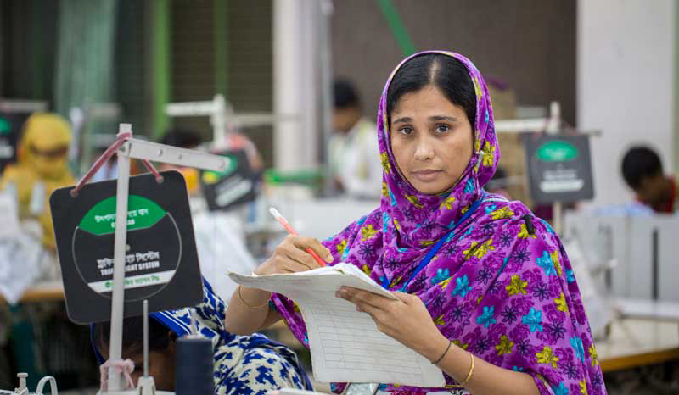
Principles of risk assessment What is competence? What is a competent person?
Competence: The combination of training, skills, experience and knowledge that a person has and their ability to apply them to perform a task safely.
Other factors, such as attitude, perception & physical ability, can also affect someone’s competence.
The competent person is someone who can apply these abilities to make informed assessments in the context of OHS.
Employers should take account of the competence of relevant employees when conducting risk assessments. This will help you decide what level of information, instruction, training and supervision you need to provide.
Notes:
Make the Point: The blue slides marked with an ‘ ’ act as a Trainer resource but are also provided in the course pack as an off course aid and reference point of good practice. As Trainer, stress that the slides provide more details/information than you will cover. Trainers will pick out key point and will not go through every item on each slide. Use you own judgement depending on the level of awareness of each group.
This slide is relatively self-explanatory and outlines the under-pinning principles that support a comprehensive approach to the risk managements process.
Briefly, run through the main points but identify that risk assessments will need to be reviewed more frequently and as workplace circumstances change – in such cases where change of equipment, raw materials, working practices or methods may impact on workers or the workplace environment then the risk process will have to address these changes as appropriate. However, let trainees know that if there is any item they wish to raise from these slides please ask them to raise the matter/issue during the session.

Slide 16
Employers’ roles and responsibilities
Ensure that, so far as is reasonably practicable, the workplaces, machinery, equipment and processes under their control are safe and without risk to health.
Ensure that, so far as is reasonably practicable, the chemical, physical and biological substances and agents under their control are without risk to health when the appropriate measures of protection are taken.
Provide, where necessary, adequate protective clothing and protective equipment (at no cost to workers)
Provide, where necessary, for measures to deal with emergencies and accidents, including adequate first-aid arrangements.
Ensure that workers and their representatives are consulted, informed, and trained on OSH
(Occupational Safety and Health Convention (No. 155) and Recommendation (No. 164)
Notes:
Trainer to reiterate employers roles and responsibilities in respect to OHS. This is recognised ‘best practice’ according to ILO instruments. However, is recognised that Bangladesh has not ratified several ILO Conventions, Recommendations or other instruments in connection with OHS. Consequently, there may be some variance between employer obligations and workers rights in connection with these principles.
The phrase ‘so far is as reasonably practical’ is also a common OHS/H&S one.
Definition: of the the term "so far as is reasonably practicable" means that the degree of risk in a particular situation can be balanced against the time, trouble, cost and physical difficulty of taking measures to avoid the risk.

Slide 17
Managers should use risk assessment to help them manage hazards, risks and worker wellbeing.
Combining these aspects in their approach.
Notes:
Trainer: Highlight importance of managing OHS integrating a range of managerial and organisational approaches.
Managers should adopt the same approach to health & safety as they would to other management and organisational issues. Managerial competencies in the aera of OHS are essential components of ‘good business’.

Slide 18
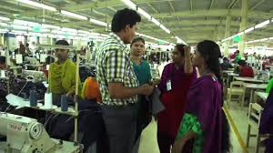
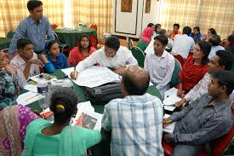
Risk Assessment: The Plan, Do, Check & Act Approach
Communicate Your Findings!
Notes:
Trainer to briefly reference the approach/process contained in this slide.
Work clock-wise around the key features from risk profiling all the way around to planning.
Ask Managers to consider whether they adopt this approach?
This approach provides the opportunity to make informed decisions about hazards and risks because it is an evidenced-based approach with an emphasis being pro-active not reactive.

Slide 19
Different types of risk assessments
The types of risk assessment required within any workplace should be proportionate and relevant to the operational activities being undertaken.
In many industries, there are specific legislative requirements that apply.
Some common types of risk assessments include:
Fire risk assessments
Manual handling risk assessments
Display screen equipment (DSE) risk assessments
Chemical risk assessments
Notes:
Trainer to highlight the fact that risk assessments are ‘dynamic’ instruments/tools.
Fire safety: management procedures are required to be established in all workplaces including a suitable and sufficient fire risk assessment.
Manual Handling: should be conducted in any workplace where an employee may be at risk from injury and/or ill-health through the need to lift, carry or move loads.
DSE: assessments are required to be completed in workplaces where employees (and others) are using computers, laptops, etc.
Chemical risk assessments are required within workplaces where hazardous substances are stored, used or manufactured.
A business may also choose to complete a Risk Assessment Method Statement (RAMS) dependent upon the nature of the operations. This process contains details of the hazard and a step-by-step procedure on how to complete work and suitably control the risks identified.

Slide 20
Workers’ rights and responsibilities
Right to remove themselves from a work situation which they have reasonable justification to believe presents an imminent and serious danger to their life or health, without undue consequences
Right to receive adequate information and training on OSH
Right to enquire into (and to be consulted on) all aspects of OSH associated with their work
Duty to co-operate with the employer in the field of OSH (e.g. comply with OSH instructions and procedures; use PPE correctly; report to supervisor hazardous situation; etc.)
ILO Occupational Safety and Health Convention (No. 155) & Recommendation (No. 164)
Notes:
Not all these rights are necessarily affirmed in the spirit of the ILO standards. There is limited trade union penetration in the RMG sector and this impacts on the arrangements above.
In the absence of trade union representation workers and employers will ordinarily communicate on matters of OHS via the workplace Safety Committee.
Are any of the supervisors or Managers members of the Safety Committee?
Ask them to identify two or three areas where they think it is very effective and two or three areas where it could improve.

Slide 21
Why are risk assessments important?
It is a legal requirement for an employer and must be documented.
Risk assessment is a straightforward and structured method of ensuring the risks to the health, safety and wellbeing of employees (and others) are suitably eliminated, reduced or controlled.
The main purposes are:
To identify health and safety hazards and evaluate the risks presented within the workplace
To evaluate the effectiveness and suitability of existing control measures
To ensure additional controls (including procedural) are implemented wherever the remaining risk is considered to be anything other than low.
To prioritise further resources if needed to ensure the above.
It can be a costly lesson for a business if they fail to have necessary controls in place.
Notes:
Trainer to highlight:
Suitable & sufficient risk assessments are the primary management tool in effective risk management.
If they fail to conduct risk assessments they could face not only financial loss (through fines, civil actions, etc) but also loss in respect of production time, reputational damage, damage to equipment, and time to train replacement employees in cases where workers are injured etc.

Slide 22
Risk Assessments are a link to other legal & employer obligations
One full time fire officer and one full time welfare officer are required by legislation if the factory has 500 or more workers (Sections 55 (12) & 79 BLR).
It is recommended that companies make sure that these persons also cover other OSH issues, and to appoint such persons in smaller factories as well. It is important that these persons have sufficient time available to conduct their tasks and have the appropriate training/qualifications.
(Remember the role of the ‘competent person’).
The fire and welfare officers alone cannot ensure a safe work environment.
They need the support of top management, other managers and supervisors.
Notes:
Trainer to highlight:
Much of the Bangladesh Labour Act 2006 and its subsequent 2015 Amendment require employers to be able to evidence their arrangements for OHS via a range of measures and arrangements including risk assessment.
Emphasise the importance of communication, consultation with workers, the role of the Safety Committee and the need to be proactive at all times in connection with OHS.

Slide 23
How to carry out a risk assessment?
It involves:
Identifying potential hazards
Identifying who might be harmed by those hazards
Evaluating risk (severity and likelihood) and establishing suitable precautions
Implementing controls and recording your findings
Reviewing your assessment and re-assessing if necessary.
Notes:
Trainer explain: The five-step process for completing a risk assessment is generally accepted as ‘best practice’.
This provides a useful checklist to follow to ensure that the assessment is suitably comprehensive.
This provides a useful checklist to follow to ensure that the assessment is suitably comprehensive.
It is important to firstly identify any potential hazards within a workplace that may cause harm to anyone that comes into contact with them.

Slide 24
Risk Assessment – a step by step process
Step 1. Identify potential hazards They may not always be obvious so some simple steps you can take to identify hazards are:
Observation: Walking around your workplace and looking at what activities, tasks, processes or substances used could harm your employees (or others)
Looking back over past accidents and ill-health records as they may identify less obvious hazards
Checking manufacturers’ data sheets, instructions, information and guidance
Consulting with employees (and others) who are carrying out the activities, tasks or processes.
It may be useful to group hazards into five categories, namely physical, chemical, biological, ergonomic and psychological.
Notes:
Trainer:
Emphasise that risk assessments are an important tool in maintaining effective OHS arrangements. However, they can also be used together with other H&S tools and techniques such as health and safety inspections or safety tours.
Ask the group, do factory OHS administrative arrangements include such practices such keeping: - Incident/Near Miss (Reporting) Book; (Incidents are accidents waiting to happen!) - Accident Book; - Sickness Records;
- A hazard Data Sheet Log (For chemicals and other toxic substances);
- Reports of Safety Inspections or tours and sampling (Air, Noise, Exhaust ventilation etc.
- These may be useful sources of information to capture data about the nature of
hazards, the frequency of incidents/accidents and their impact on workers.
Explain the usefulness of listing hazards in to the five areas highlighted above.
This help to order types of hazards in to particular categorises and aids in separating out control and management responses in a more coherent manner.

Slide 25
Risk Assessment – a step by step process
Step 2. Identify who might be harmed by those hazards
Note how individuals or groups of workers could be affected, be it through direct or indirect contact or by certain types of exposure. (Remember, some hazards or injuries may be affected by such factors as time, weight, age, etc).
It is not necessary to list people by name, rather by identifying groups e.g.
Employees
Contractors
Members of the public/visitors
Some hazards may present a higher risk to certain groups including young people, new or expectant mothers, new employees, home workers, and lone workers etc.
Notes:
Trainer highlight people who may be affected may include workers who fit into ‘vulnerable group’ categories. E. g. young workers; pregnant women etc.
Remember, there may be specific legislation or guidance limits for some of these workers.
For example there is a limit to the weights that women can lift compared to a man in the BLA 2006 Act (Amended 2015). See ‘Clause 63 Extra Weight’

Slide 26
Risk Assessment – a step by step process
Step 3. Evaluate risk severity and establish precautions
It is important to evaluate the severity the risk may present and establish suitable and effective controls to reduce this level of risk as far as is ‘reasonably practicable’. This means that everything possible is done to ensure health and safety considering all relevant factors including:
Likelihood that harm may occur
Severity of harm that may occur
Knowledge about eliminating, reducing or controlling hazards and risks
Availability of control measures designed to eliminate, reduce or suitably control the risk
Costs associated with available control measures designed to eliminate, reduce/control risk
Assessing the severity of a risk requires an evaluation of the likelihood of an occurrence and how substantial the consequences that it may cause. Factors affecting this evaluation include the duration and frequency of exposure, number of persons affected, competence of those exposed, the type of equipment and its condition, and availability of first-aid provision and/or emergency support.
Notes:
Trainer explanatory note for phrase sfairp: The term "so far as is reasonably practicable" means that the degree of risk in a particular situation can be balanced against the time, trouble, cost and physical difficulty of taking measures to avoid the risk.
Having identified any hazards and who might be affected consider the scale and potential impact of the hazards.
If the risk cannot be eliminated, analyse which are the most appropriate control measures. This process is known as the ‘hierarchy of control measures’ which we will discuss later on in the course.
Review all those who may be exposed to the hazard; be involved in the task or potentially endangered by the hazard in the short, medium or long-term.
Objectively review the nature of the risks and evaluate the capacity of the organisation to introduce and monitor the measures introduced.

Slide 27
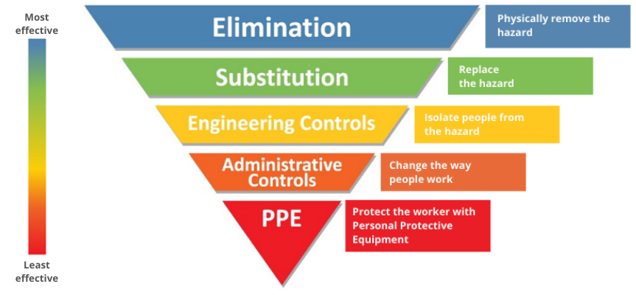
Risk Assessment: The ‘hierarchy of control measures’.
Risks should be reduced to the lowest reasonably practicable level by taking preventative measures, in order of priority.
Consider the headings in the order shown, do not simply jump to the easiest control measure to implement.
Notes:
Trainer: Self-explanatory slide.
The hierarchy works downwards in terms of effectiveness. The approach should not be to identify a hazard and then simply give workers Personal Protective Equipment (PPE).
The ideal approach is to remove the hazard (e.g. a toxic chemical and replace it with a less hazardous alternative).
When we provide workers with PPE we are basically saying we can’t replace the hazardous substance and therefore our last resort is to give the workers protection.

Slide 28
RISK MANAGEMENT STRATEGIES
Understanding how a risk matrix ratings work
CERTAIN
Low
Moderate
High
Extreme
Extreme
LIKELY
Low
Moderate
High
High
Extreme
LIKELIHOOD
POSSIBLE
Low
Moderate
Moderate
High
High
UNLIKELY
Low
Low
Moderate
Moderate
Moderate
RARE
Low
Low
Low
Low
Low
INSIGNIFICANT
MINOR
SIGNIFICANT
MAJOR
CATASTROPHIC
SIGNIFICANCE
Notes:
Trainers: Ask the group if they know how the matrix works? If someone answers yes or if the Safety Manager is available ask them to explain. This encourages peer–to–peer learning/teaching and gives you the chance to draw on the resources in the group. If no one comes forward then briefly explain how the risk matrix works.
Emphasise: We’ve explored the nature of hazards & risks and talked about the ‘likelihood’ and ‘significance’ or ‘consequences’ if there is an accident.
So, to explore the risk rating we have to calculate whether the hazard in question is likely to happen and if it does what will be the outcome or consequence for the individual or groups of workers.
We ‘weight’ or score the factors Low, Medium or High (see colours on slide) depending on the likelihood, and significance/consequence. If the hazard scores relatively low on both matrices (Likelihood & significance) then the overall risk would also be low. If it scores high on both likelihood and significance then the hazard will be a serious risk.

Slide 29
RISK MANAGEMENT STRATEGIES
Understanding how a risk matrix ratings work
CERTAIN
Low
Moderate
High
Extreme
Extreme
LIKELY
Low
Moderate
High
High
Extreme
LIKELIHOOD
POSSIBLE
Low
Moderate
Moderate
High
High
UNLIKELY
Low
Low
Moderate
Moderate
Moderate
RARE
Low
Low
Low
Low
Low
INSIGNIFICANT
MINOR
SIGNIFICANT
MAJOR
CATASTROPHIC
SIGNIFICANCE
Notes:
Trainer: Ask the group to look at the matrix again and ask them how they would score some of the workplace hazards they identified earlier in the course? (Pick 2 or 3 and ask them to explain how they arrived at their conclusion/findings?)
-----------------------------------------------------
*Please note: Do not show film below to trainees. This is for trainers use only. The link below takes you to a You Tube video which very simply explains the risk matrix process to any Trainers who may not be too confident about trying to describe the process.
https://www.youtube.com/watch?v=-E-jfcoR2W0 (Ctrl + click to access film).
The film is only a few minutes long, so it is suggested that a colleague who speaks both Bangla and English takes non-English speaking colleagues through the film stopping to translate the film at intervals so they understand the visuals but also the narrative accompanying the film.
It is not suggested that this film is shown to Trainees.

Slide 30
RISK MANAGEMENT MODEL
Another example of a Risk Matrix
Close monitoring required
Requires monitoring and management
Intensive management
HIGH
Risk may be accepted, but requires monitoring
IMPACT
Management recommended
Management required
MEDIUM
Risk acceptable, requires regulation
LOW
Acceptable risk
Managed
LOW
MEDIUM
HIGH
LIKELIHOOD
Notes:
Trainer:
This is a slide just to illustrate that there are different risk matrix templates and this is am example slightly different than the ones in the previous slides.
Briefly, highlight that some aspects are similar, whereas others vary slightly (wording/layout) but the overall process is the same and the rating or outcomes would probably also be similar.

Slide 31
Risk Assessment – a step by step process
Step 4. Evaluate risk severity and establish precautions
Risk assessments findings should be kept securely (electronically or in writing). Recording findings on a risk assessment form helps keep track of the risks and control measures put in place to reduce the identified risk. The form includes:
What hazards were found
Person(s) or groups affected
The controls put in place to manage risks and who is monitoring them
Who carried out the assessment
On what date the assessment was done.
It is sensible to ensure the risk assessment is proportionate to the activity or task being carried out and this can often be a straightforward process for generic tasks.
Notes:
Trainers The words ‘risk assessment form’ in the first paragraph of the slide are hyperlinked to an iosh (Institute of Safety & Health) example.
It might be worth asking one of the Managers before the course if they have an example of a R/Assessment they could show and ask them to explain what the document covers.
If there isn’t an example available in the factory, this is a standard example of an internationally accepted template available via the hyperlink may be worth highlighting.
It may be worth having this translated in to Bangla.
Trainers may wish to explore a few questions to with Supervisors e.g.
Do Supervisors know where risk assessments are held/stored in the factory?
If a Supervisor had witnessed a H&S incident occurring and he/she felt that the job or task might need risk assessing again due to changing circumstances, how would they go about organising another R/Assessment?
Can managers/Supervisors confirm that R/Assessment are discussed on the Safety Committee? If so, give an example. If not why not? (Do they think the S/Committee should consider R/Assessments?)

Slide 32
Risk Assessment – a step by step process
Step 5. Review your assessment and reassess if necessary
Employers should periodically review the assessment and if necessary, re-assess any controls in place.
A good guide as to when you may need to review your processes are:
After any significant change within the workplace or production process in question
After an accident or ill-health incident has occurred
After near-miss incidents have been reported or observed.
A change of raw materials or product which may present or new hazards.
It may be appropriate for the factory Safety Committee to review risk assessment as a standing agenda item.
Notes:
Trainers. Self-explanatory slide.
Reference the examples highlighted on the slide.

Slide 33
What documentation do you need?
It is a misconception that risk assessments inherently involve a vast amount of paperwork. It can be as straight forward for many generic tasks or activities.
Employers should record significant findings including:
Any hazards identified
Controls measures in place, and information on any further control measures that are required
Any individuals that have been identified as being especially at risk.
There is no set amount of time that you are required to retain the risk assessment, but it is best practice to keep it as long as is considered relevant to a particular task or activity.
Notes:
Trainers: Summarise Risk assessments are an integral part of ensuring the health, safety and wellbeing of everyone within the workplace.

Slide 34
Risk Assessment Quiz
If participants are accessing individual computers send them the Risk Assessment Quiz in the chat ask them to press ‘ctrl & click’ to enter the short Microsoft forms quiz form.
Use you cursor to click and answer your questions
For question 4 – they should type their answers in to the box provided.
They should click ‘Submit’ when they have answered all the questions.
Copy of quiz questions Risk Assessment Quiz
Summary of Trainees Answers
Notes:
Trainer: explain Trainees are to follow instructions and ‘Ctrl click’ link. This will take them to a short quiz.
Once they have answered the questions they should click ‘Submit’
The Ctrl click link below will collate their answers. Once you have clicked on the link go to ‘Responses’ to see summary of participants answers.
Summary of Trainees Answers

Slide 35
Some final considerations for Managers
In groups (or individually), draft some brief answers to the questions below and be prepared to discuss your findings with the whole class.
How often does the company refresh its assessment of the top OHS risks?
What are the company’s top five OHS risks, how severe is their potential impact and how likely are they to occur?
What are the top three accidents or health complaints that have occurred regularly in the factory in the last year?
How effective is the company in managing Covid-19 OHS risks?
Are there any organisational “blind spots” warranting attention? (E.g. Culture or behavioural issues; a lack of transparency or communication - that may compromise the effectiveness of risk management arrangements.

Slide 36
Some final considerations for Managers
In groups (or individually), draft some brief answers to the questions below and be prepared to discuss your findings with the whole class.
Does the Safety Committee play an effective role in reviewing the risk assessment process? (Explain how).
Does the company need to train more Supervisors and Managers in how to carry out health & safety inspections?
How does the company communicate the findings of its risk assessments to workers?
If a Health & Safety Inspector visited the factory today, how confident would the company feel about its risk register/record keeping?
Were women workers consulted about the risks affecting female workers?

Slide 37
Some final considerations for Managers
Off-Course Activity:
Using the resources provided (see link contained in slide 31 Risk Assessment Step 4) which includes a template for a risk assessment
Complete the risk assessment for a hazard in your section/department or area – use the risk matrix to score your hazard Low, Medium or High.
Discuss your findings on Day 2 of the course.

