Slide 1
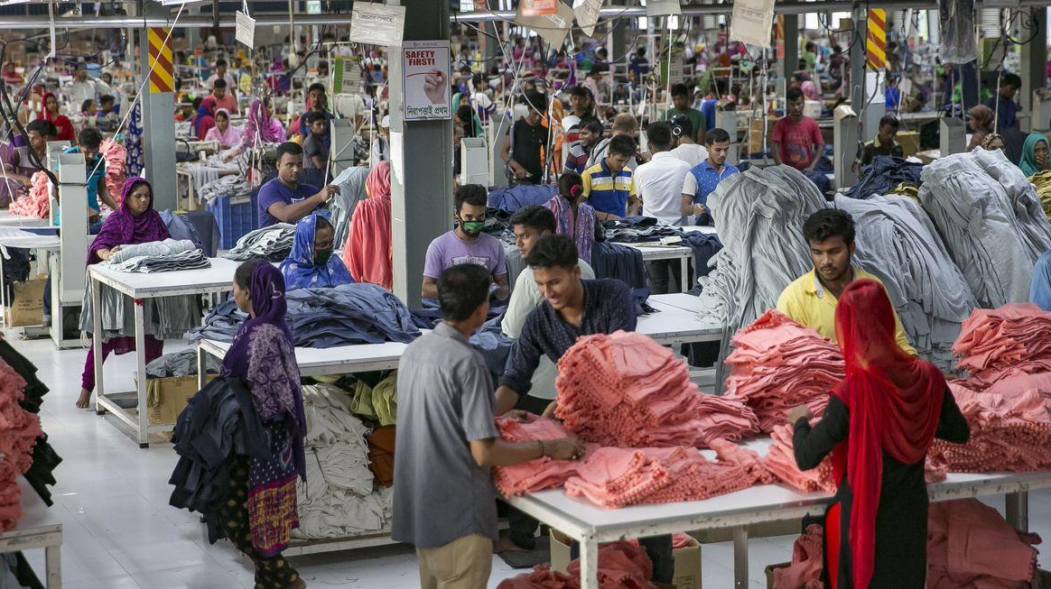
Human Factors in OHS
Introduction to OHS: Module 4
Supervisors & Managers Introduction to Occupational Health & Safety (OHS) Online Course
Notes:
Trainer:
Introduce this 4th module with a quick reference to modules and that central to all these aspects of OHS is the worker. All too often in H&S, workers get the blame for accidents and although this may be legitimate on a few occasions, things are a bit more complex than it always being simply the workers fault!
Although human failure is at the heart of around 90% of accidents, (apart from the worker) failures can extend to Supervisors, Managers, equipment, machinery, OHS culture, poor communications, inadequate PPE/training; systems failures and workplace conditions.
So in this module we’re going to explore how our perception of risk; our interpretation of the information upon which we make decisions and, ultimately how we act, can be affected by our personality or character as much as by external factors.
We’ll now move on to cover Human Factors; Ergonomics; Communication and briefly, reference women workers, Bullying & Harassment and Mental Health. Many of these topics could be courses in their own right, so we will combine aspects of these subjects under the heading of human factors and, as you have seen, we have covered elements of these areas in earlier modules.
Depending on your previous knowledge or training, this may well be one of the more challenging topic areas. Ask the trainees if any of them have been involved in any OHS work around ergonomics?
If very few have, remind them, we all have our own comfort-zones, if this is a new subject area for you remain objective even if at first it may appear a little abstract.

Slide 2
Aims and objective of Module 4
To explore the field of human factors in the context of health and safety:
By the end of the session you will be able to:
State the factors that promote a good health & safety culture Distinguish organisational, job and personal factors involved in accidents Identify how human error can contribute to accidents Identify potential failings in communication, work design and understand the influence of human factors & ergonomics on OHS.
Notes:
Trainer:

Slide 3
FOUR STAGES OF OHS CONTRIBUTION MODEL
Stage 4
Stage 3
Anticipated Impact Following OHS Training
Stage 2
Stage 1
Contribute
Dependently
Contribute
Independently
Contribute
Through Others
Contribute
Strategically
Key Transitions Following Acquisition of knowledge & Skills (Novation’s)
Notes:
Trainer:
The other thing to say is that as we have progressed through each module we have endeavoured to show how you can contribute to improve OHS in this factory.
Firstly, by contributing individually by following company OHS policy, rules and procedures;
Secondly, in understanding your role you are able to contribute as a Supervisor/Manager by carrying out your OHS role & duties without having to depend on direction;
Thirdly, by leading a team/section/the staff you are responsible for follow your instruction which extends your reach to influence OHS with their cooperation; and
Fourthly, by enhancing your knowledge & skills following this straining by being proactive, solution-focused and now hopefully

Slide 4
Human Factors (1)
When looking for the causes leading to human failure or error in accidents, it is necessary to look at:
Organisational, job and personal factors as key components of any accident investigation.
It is also useful to consider these aspects when considering workplace design/ergonomics, safe systems of work and OHS arrangements
Notes:
Trainer: Self-explanatory slide.

Slide 5
Organisational factors (2)
Organisational factors have the major influence on individual and group behaviour, yet it is not uncommon for aspects of the organisation to be overlooked for example:
Poor work planning leading to high work pressure/stressful environments Lack of safety systems/barriers/precautionary measures Inadequate response to previous accidents Management based one-way communications Poor coordination of work & responsibilities Poor management of health and safety Poor health and safety culture
Notes:
Trainer: Self-explanatory slide. Run through the examples. Ask the trainees if they can think of any others? E.g. Lack of provision of PPE, ‘blame culture’, not maintaining Covid-19 protective and precautionary measures or bullying & harassment by Supervisors & Managers.

Slide 6
Job Factors (2)
Job factors jump factors directly influence individual performance and the control of risk. Examples include:
Iillogical design of equipment/instruments Constant disturbances and interruptions Missing or unclear instructions Poorly maintained equipment or PPE High workload (Often driven by managerial bullying & harassment) Noisy and unpleasant working conditions
Notes:
Trainer: Self-explanatory slide.
Run through the examples. Ask the trainees if they can think of any others?
E.g. No proper job descriptions; expectation of too many complex tasks to be completed in a short period of time; time demands requiring workers to take short cuts and possibly compromised health & safety; pregnant women being expected to do jobs that may endanger their health etc.

Slide 7
Individual/Personal Factors (3)
These are the attributes which workers bring with them to their jobs – they many be strengths or weaknesses for example:
Mental attributes & agility: - Habits, attitudes, skills/competency & personality - problem-solving abilities, leadership/communication skills, coaching & mentoring skills
Physical - dexterity, strength, speed, resilience & coordination
Multi-skilled - Hand-eye coordination, take individual responsibility or work as & a team player, - Experience, understanding, flexible & able to accommodate change.
Notes:
Trainer: Self-explanatory slide.
Run through the examples. Ask the trainees if they can think of any others? E.g. ability to work meticulously/with attention to detail; ability to sequence work or respond to changing circumstances etc.

Slide 8
Personal factors can also include…(4)
Differences in personality (one persons stress is another persons motivation) Differences in the way people accommodate change
Differences in abilities, judgement, educational attainment, physical strength and dexterity Disability's or other medical problems
Attitude, skills/competence levels & Resilience,
Ability to manage stress
Differences in opinions, confidence, risk perception etc.
Notes:
Trainer:
Self-explanatory slide.
Highlight that every human/worker is unique and we are sometimes influenced by a variety of circumstances and conditions which can temporarily or even momentarily alter of personality, judgement and perception.

Slide 9
Personal factors (5)
Attitude - the tendency to behave in a particular way Motivation - the driving force behind the way a person acts Perception - the way in which a person understands the situation knew line skills dash competence levels Personality - what makes you what you are
Notes:
Trainer:
Highlight these factors asking trainees to reflect on the nature and personalities of some of their co-workers.
Certain people may have a propensity to act in a particular way in certain circumstances, but we should not be judgemental as in any given circumstances we may act in a similar way.

Slide 10
Perception – the ability to see, hear or become aware of something through the senses…
the way in which people interpret presented and given information and then apply it to the given situation or task Many accidents occur because people do not perceive that there is a risk Hard hats Guards on machine Washing of hands before eating
Covid-19 peoples attitudes to wearing masks, washing hands and social distancing – some people insist on violating rules
Notes:
Trainer:

Slide 11
Perception
view the following slides The brain can at times have difficulty in interpreting presented visual information
Notes:
Trainer:

Slide 12
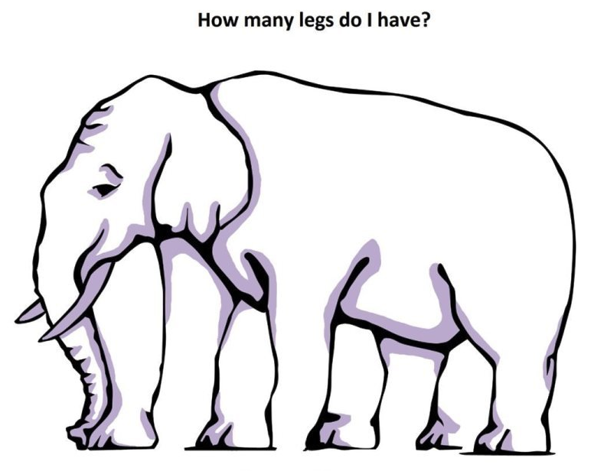
Is this book looking towards you……or away from you?
Notes:
Trainer: Self-explanatory slide.
Highlight the point that not everyone sees the same thing.
Our perspectives or interpretation of images, events or situations are often different and we can change our mind.
(This is true with how different people perceive risk.
It is also apparent when witnesses to an accident may re-tell different versions of the same incident and seem to contradict each others version of the facts or evidence. Often bias and perspective can influence how we interpret health and safety issues).
Remember, Supervisors/managers be clear when you communicate either verbally or visually. Consider how the message you are trying to get across is being received by your audience and what may influence their interpretation or understanding of the message being communicated.

Slide 13
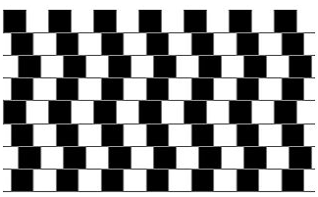
Are the lines crooked or straight?
Notes:
Trainer:
The lines are perfectly straight and parallel.
However, sometimes, visually, we interpret things differently or hesitate before we decide because we visually and cognitively filter information simultaneously.
When this happens there can be confusion as what we see may not correspond with what we understand – our mind can play tricks on us!
Such situations can lead to mis-judgement, errors or poor decisions which cause accidents.

Slide 14
Look at the chart
Say the colour of the word, not the word itself
Why is it hard?
Notes:
Trainer:
Our brain wants to say the word - not the colour of the word.
We are often seemingly ‘programmed’, or our brains are ‘wired’ to react in a conditioned manner.
Sometimes we may realise something is wrong or unsafe, but we react by impulse or counter-intuitively or contrary to common-sense. These situations can also be complicated by, for example:
- Workers being tired or stressed - Poor communications or instructions - A lack of training; poor safety culture or poor workplace conditions (noise, temperature, distractions etc.)
All these kind of situations can affect judgement, perception of risk and influence the potential for accidents in the workplace.
Remember, these aspects when designing work, the workplace or communicating OHS information or instructions.

Slide 15
Communication
Communication is concerned with the creation, transmission, interpretation and use of information. There are four basic steps to communication:
Intent: the sender has information that they wish to communicate to others;
Transmission: the sender chooses a method to convey the information (e.g. speech, writing, signs);
Receipt: the receiver hears or sees the information;
Interpretation: the receiver makes sense of the information that they have received.
However, what is interpreted is often different to what was intended – leading to a communication failure which in turn may lead to OHS accidents.
Notes:
Trainer:
Self-explanatory slide.
Remember as a Supervisor/manager good communication is one of your most effective tools (if delivered correctly) – if not it can become one of the causes or failures that lead to incidents or accidents.
Remember to check with workers that they have understood your instructions. Not just by saying: ‘Do you understand’? But by asking them to relay back to you what you have asked them to do. (Especially in safety critical situations involving fire, electricity or issue associated with chemicals.

Slide 16
Communication
Activity:
Group 1: List the reasons why a verbal instruction may not be clearly understood by a worker.
Group 2: Outline FOUR advantages and FOUR disadvantages of using propaganda posters to communicate health and safety information to the workforce.
Notes:
Trainer: Either as an online discussion or in classroom, split the trainees in to 2 groups.
Give the trainees 3-5 minutes – ask the trainees to answer the question given to their respective group. Ask them to report back, in summary you could include: Group 1: Examples: Noisy environment. Poorly communicated instruction. Instruction too complex to understand. Worker interprets request differently. Too many instructions at once. Worker not skilled or knowledgeable enough to comprehend instruction. Worker distracted. Supervisor did not use workers name so unclear as to who was supposed to carry out instruction. Group 2: Advantages: Examples: Can be seen – use of visual sense – work does not have to hear. Message remains on permanent display. Can use colour and images to attract attention. ‘A picture paints a thousand words’ – gets message across simply. Reinforces H&S messaging. Message is consistent and can’t be misinterpreted by workers who can often mishear or interpret words differently. Disadvantages: Workers forget posters are there, as they just become ‘wallpaper’ and are ignored or the message is forgotten about. Workers may not think message applies to them. Posters can be hidden if something is put in front of them. The message in the poster may not be clear or may be misinterpreted. Posters can be defaced with graffiti. Sometimes the images and wording on posters appear to give contradictory messages. If the message isn’t clear workers ignore posters. Workers get distracted so it is difficult to reinforce message over time unless their attention is drawn to poster for a reason.

Slide 17
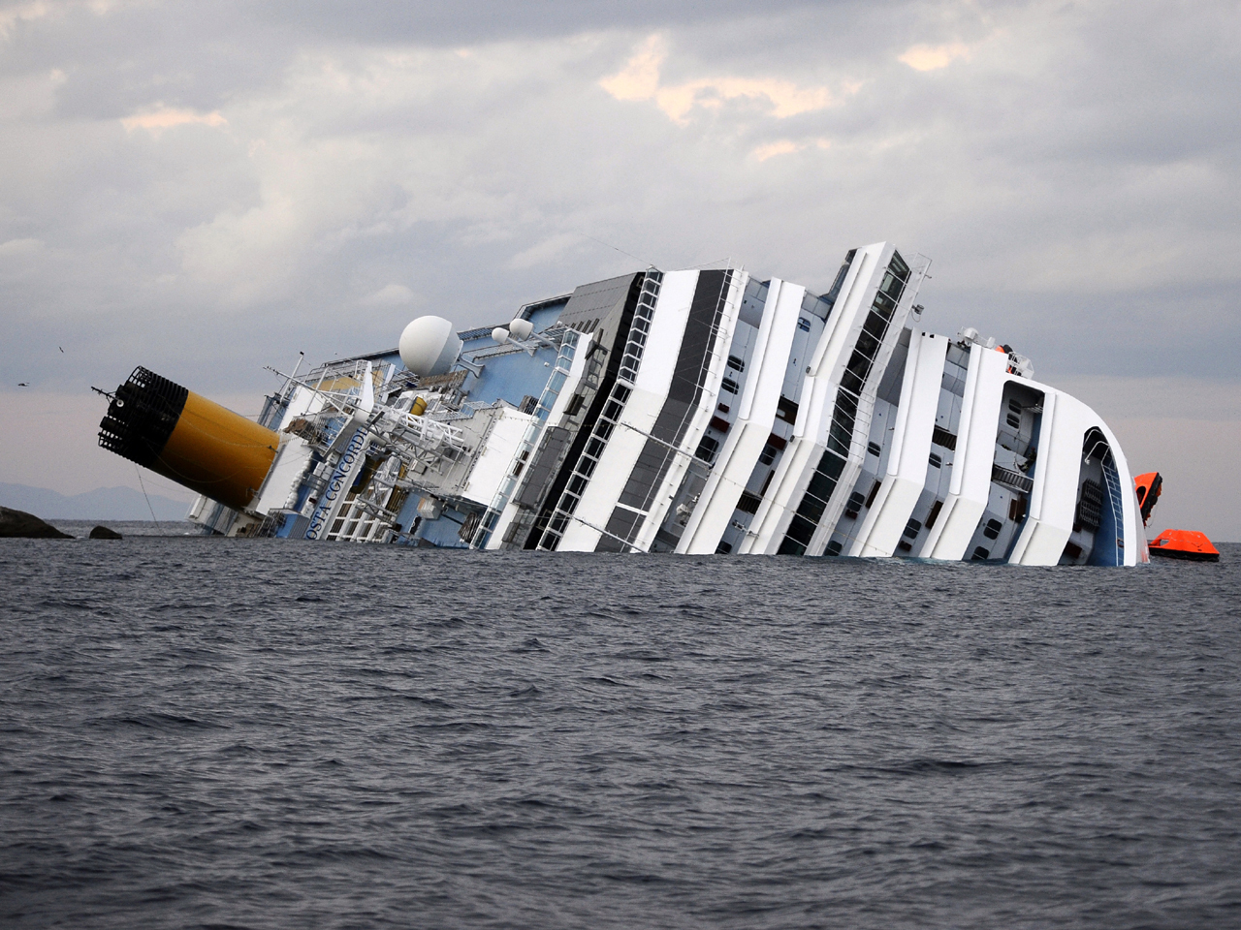
Importance of human factors has been recognized for a long time in the…
Aviation industry
Nuclear sector
Maritime sector
These are all particularly safety critical industries where human error ‘on the job’ can have critical implications for the individual but also hundreds or thousands of others.
Notes:
Trainer:
Although these are the more higher profile applications of human factors & ergonomics the same principles apply in other workplaces as near-misses, minor and serious accidents can have similar impacts on health, well-being and even life.
These sectors have adopted systematic approaches to safe systems of work; job design; ergonomics and located human factors as an integral part of their OHS management systems.
We can learn much from their experiences. However, things can still go wrong and we need constant vigilance to prevent accidents and hazards to ill-health.
See the next two slides on the airline industry as an example.

Slide 18
Combining ergonomics & human factors. By the end of this section you will be able to:
Define
Define ergonomics and its benefits
Identify
Identify parts of the body that get injured at work
Identify
Identify work activities that can lead to injury
Notes:
Trainer: By the end of this module, you will have learned to:
Define ergonomics and list the benefits of good ergonomics in the workplace
Identify the parts of your body that are most likely to get injured at work
Identify and explain work activities that can lead to injury.

Slide 19
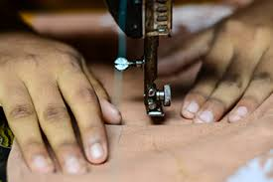
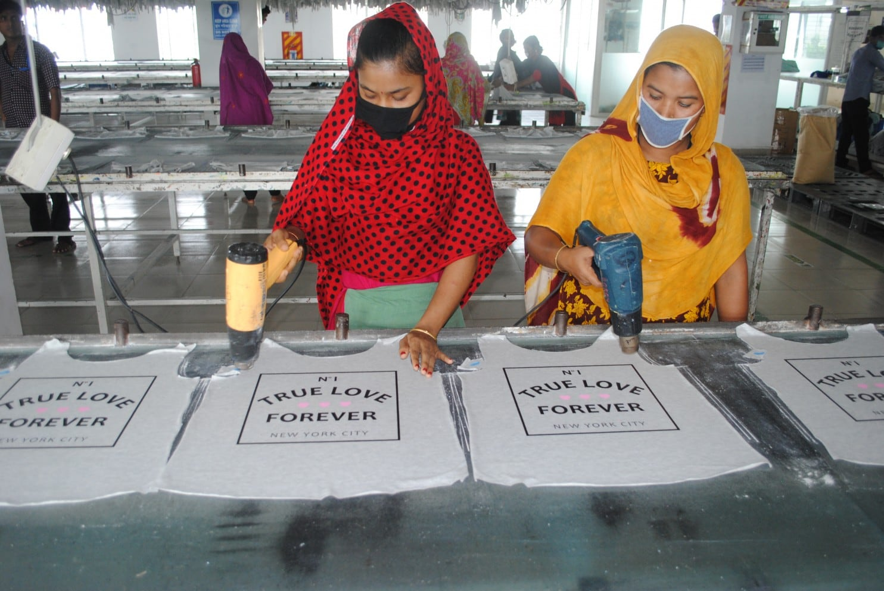
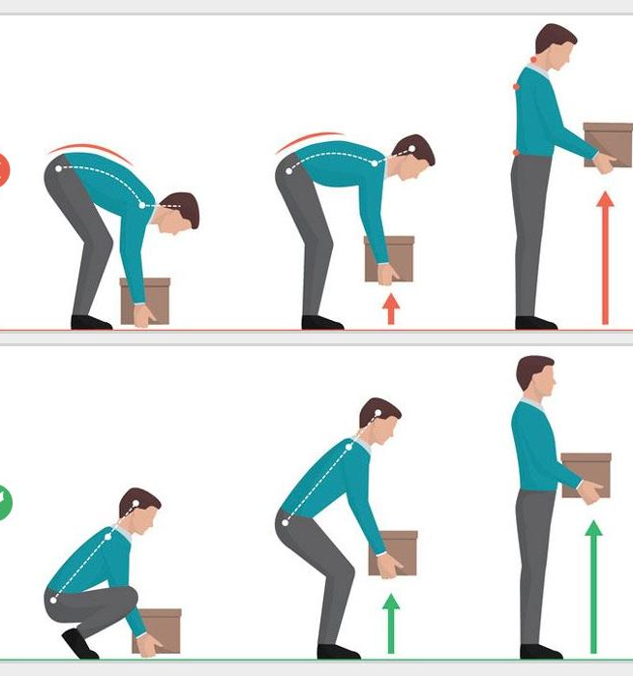
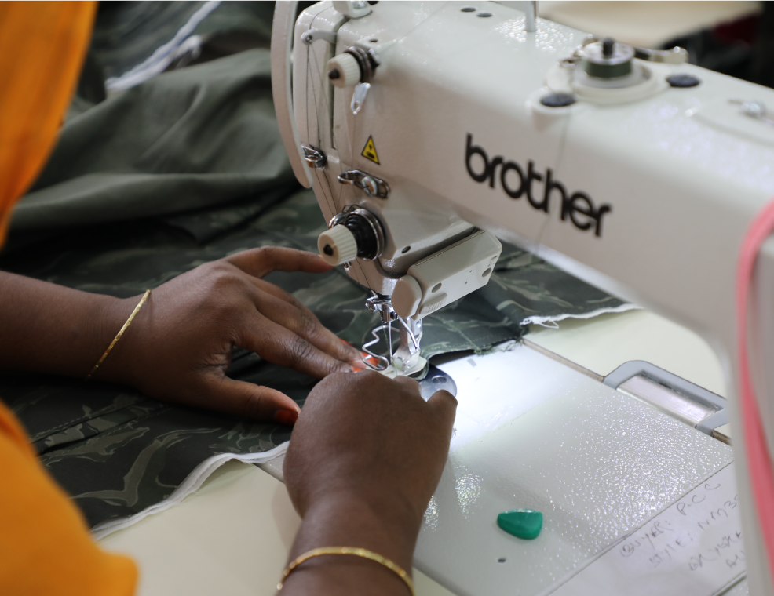
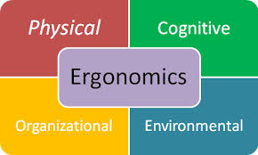
Human factors and ergonomics are concerned with the "fit" between the user, equipment, and environment or "fitting a job to a person"
(Occupational Safety and Health Administration“ 2019. www.osha.gov).
Notes:
Trainer: (Animated slide – when slide shows do not click to fill
Workers are not robots and therefore they are affected by a range of internal and external influences which can have both positive and negative impacts on their mood, spirit, performance and judgements.
Human factors are, in part influenced by these elements and concerned with understanding and managing the capabilities and limitations of people. This area of OHS is also referred to as ‘ergonomics’ (which drives from the Greek language ‘Ergon’ means work and ‘Nomos’ means law so ergonomics means the ‘Laws of/or the science of work’.
Click to drop in quote – now.
It is the application of knowledge and principles - combined with an appreciation of human psychology – as well as lessons learned from previous incidents that we can look to optimise OHS arrangements.
The goal of human factors is to reduce human error, increase productivity, and enhance safety and comfort with a specific focus on the interaction between a human and the thing of interest (work/equipment).
It sounds quite technical but it is not. Lets look at some definitions, next slide…

Slide 20
Defining human factors in occupational health & safety
"Human factors refer to environmental, organisational and job factors, and human and individual characteristics, which influence behaviour at work in a way which can affect health and safety“ (HSE, UK)
We define human factors as: the study of all the factors that make it easier to do the work in the right way. Another definition of human factors is the study of the inter-relationship between humans, the tools and equipment they use in the workplace, and the environment in which they work. (World Health Organisation)
"Human factors" is an umbrella term for several areas of research that include human performance, technology, design, and human-computer interaction. It is a profession that focuses on how people interact with products, tools, procedures, and any processes likely to be encountered in the modern world. (Wikipedia)
Notes:
Trainer: Ask the trainees to consider the definitions. Don’t read them all out maybe focus on either the HSE , UK or WHO definitions.
Ergonomics is a combination of numerous disciplines, such as psychology, sociology, engineering, biomechanics, industrial design, physiology, interaction design (worker-machine interface), visual design, and user experience. So, the exact definition of Human Factors/Ergonomics (HF/E) varies.
But by now, you should all have a general idea of what we mean.

Slide 21
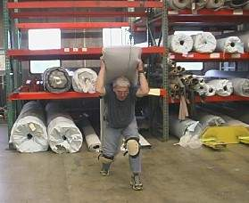
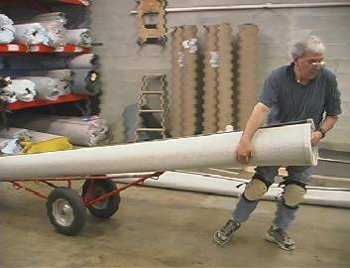
Risk of injury - Heavy lifting
Trolley takes weight, pressure & reduces risk
Ergonomics at Work…because work shouldn’t hurt!
When it does it causes WRMSDs
Notes:
These pictures show the difference between lifting and moving something heavy and awkward by hand (in this case a roll of material) and moving the same thing with the help of a co-worker and mechanical assistance (in this case a trolley).
Lifting the material without assistance might create a risk for back or shoulder injury. The science of ergonomics teaches us that using the trolley puts less strain on the back and shoulders, and it’s also less tiring overall.
The worker who gets help is a lot more likely to have a little energy left at the end of the day, and in the long run is a lot less likely to have injuries and miss work.
Ergonomics is about making jobs easier and reducing the risk of injury.
*When you use the phrase WRMSD – if no one asks what the term means, pause for a moment, then ask them why they didn’t ask?
We need to be talking the same language. If they don’t ask, how will they understand? There are no stupid questions when it comes to OHS.
Use this incident as an example of ‘communication breakdown’ which you should refer to later when we touch upon sending messages and how they are received.
(If someone in the group does ask – great – then ignore this comment!

Slide 22
What are Work-related Musculo-Skeletal Disorders (WRMSDs)?
WRMSDs are also known as:
Cumulative Trauma Disorders (CTDs)
Repetitive Strain Injuries (RSIs)
Overuse injuries
They are joint and soft tissue injuries which occur gradually
Notes:
Trainer:
These injuries are called work-related musculoskeletal injuries, or WRMSDs. You may have heard of these injuries by another name, such as Cumulative Trauma Disorder, or CTD; repetitive strain injury, or RSI; or overuse injuries. WRMSDs affect the soft tissues of the body - the muscles, tendons that connect muscles to bones, ligaments that connect bone to bone, nerves, blood vessels, pretty much every part of your body that’s not a bone or internal organ.
These are the parts of your body that are prone to injury when demands on them go beyond what they can handle. Typically these injuries occur in your body’s joints, the moving parts of the body like your low back, wrist, shoulder, elbow and knee. These are the parts of your body that get used the most and that are placed under the most stress during the day.
Often these injuries start out small, as a little muscle pull or a slightly irritated tendon. However, if a small injury isn’t given a chance to heal, it can become aggravated, especially if you keep doing the activity that caused the injury in the first place. Over time, these small injuries can build until they become chronic, and at this point they become a WRMSD.

Slide 23
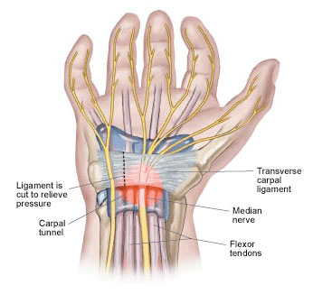
What causes WRMSDs?
Heavy, Frequent, or Awkward Lifting
Pushing, Pulling or Carrying Loads
Working in Awkward Postures
Highly intensive/repetitive hand work (such as that done by sewing machinist or typists)
Notes:
Trainer:
The activities on the slide are risk factors. and repetitive motions. These hazards can also be complicated by the use of equipment and vibration conditions. We don’t know the figures for Bangladesh but for example in the European Union:
Roughly 3 out of every 5 workers in the EU-28 countries report MSD complaints.
The most common MSDs are backache and muscular pains in the upper limbs.
Of all workers in the EU with a work-related health problem, 60 % identify MSDs as their most serious issue
1 out of 5 people in the EU-28 suffered from a chronic back or neck disorder in the past year.
Prevalence rates of MSDs are higher for female workers than for male workers. The likelihood of reporting MSDs increases significantly with age. Workers with only pre-primary/primary education more likely to WRMSD & more likely to report chronic MSDs Source: https://euosha.blumm.it/muskuloskeletal-disorders

Slide 24
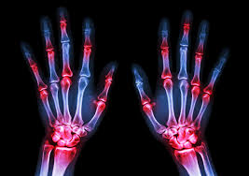
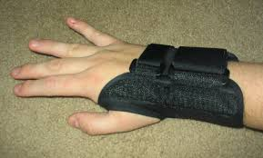
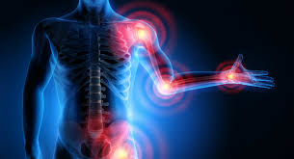
Notes:
Trainer:
The interaction between the work environment and the human body is complex.
Limiting ourselves to a singular cause of MSDs will limit our ability to develop a prevention strategy that addresses all causes of MSDs.
It is necessary to address both workplace risk factors and individual risk factors.
The WRMSD ‘continuum’ will replicate the same accidents and injuries in workers if we do not adopt an ergonomic approach address workplace, job & individual risk factors.
The image (Yellow/Orange & Red) on the left of the slide shows what will continue to happen if the situation is not addressed. Image on the right (Blue) illustrates proactive approach to tackle risks.

Slide 25
Benefits of ergonomics
Adopting an Ergonomics approach helps to prevent injuries
Ergonomics has other benefits
Improved quality of work
Improved quality of life
Reduced fatigue and discomfort
Improved productivity and performance
Reduced sickness absence
Notes:
Trainer: So, we can see that ergonomics isn’t just a ‘science’, it’s a tool that can be used to improve jobs and make them safer.
Changing aspects workers jobs/work environment so that it better ‘fits them’ has other benefits as well. They may find they are able to do a better job because they have more energy and can concentrate on work.
Remember, there may be a number of changes that you can make to the way the job is done that will make it both safer and better.

Slide 26
What happens when we get the individual, job task & design wrong!

Slide 27
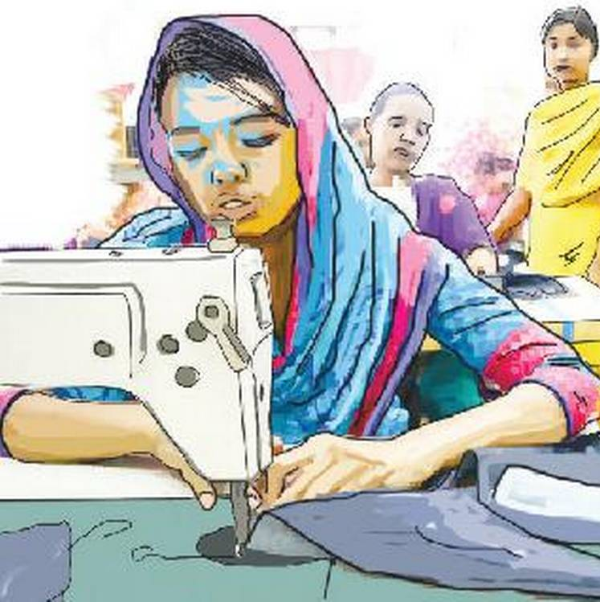
Individually, or in groups, make a list of the potential hazards, injuries or ill-health complaints faced by sewing machinists.
Activity A:
Notes:
Trainer:
If group do/don’t provide answers supplement & summarise with list of potential injuries that could include:
- needle punctures (Injuries to eyes from broken needles); - Repetitive Strain Injuries (RSI);
- carpal tunnel syndrome in the wrist; - low back pain/shoulder strain/trapped nerves and poor circulation due to hard surfaces.
Research also highlights the following health aliments/problems affecting women workers in the RMG sector:
Show next slide
WRMSDs tend to occur gradually, accumulating from months or even years of work, as opposed to sudden injuries such as a broken bone due to a fall.

Slide 28
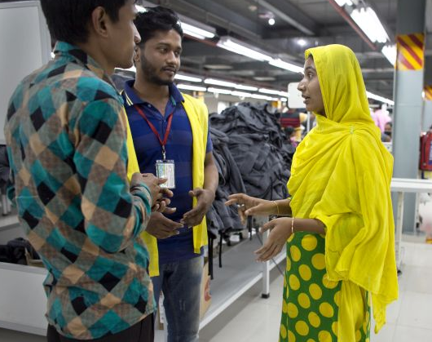
Women’s Occupational Health Problems/Hazards in the RMG sector, include: * burns and puncture wounds, * physical hazards, such as heat and noise, chemicals, * dust/ respiratory problems. * allergies, ergonomic hazards posed by poor posture, * biological hazards from poor nutrition * psychosocial/stress hazards ones that result from abuse, * bullying & sexual harassment of supervisors * depressing work environment. * mental health, stress & anxiety * gynaecological problems The most common health problem attributed to their occupation by garment workers was the incidence of musculoskeletal disorders (MSD). These aspects do not receive adequate attention in many garment factories. Thus, in most cases, workers do not create hazards - hazards are built into the workplace
Notes:
Trainers:
The most common health problem attributed to their occupation by garment workers was the incidence of musculoskeletal disorders (MSD). This was also the primary cause for workers seeking medical attention.6
The most common MSDs include tendonitis, epicondylitis (Tennis or Golfer’s Elbow), bursitis, trigger finger, carpal tunnel syndrome and back strain. MSD prevalence is found to be particularly high among tailor & machinists . Exposure to cotton dust causes irritation in the upper respiratory tracts and bronchi, which after prolonged exposures slowly progresses to chronic obstructive pulmonary disease. Besides all garment industries have dust problems. Dust fibres mainly produced from cutting and sewing. The need to meet production targets forces workers to cut short lunch breaks, or even skip them altogether. They often do not drink enough water in order to avoid going to the restroom. This predisposes them to Urinary Tract Infection (UTI). Source: Padmini DS & Venmathi A, Unsafe Work Environment In Garment Industries, Tirupur, India
Bobby Joseph & Pretesh Rohan Kiran, A Stitch In Time ... Annual Health Appraisal Of Garment Industry Employees
Trainers:

Slide 29
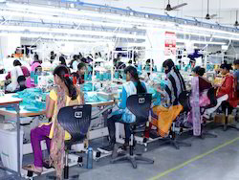
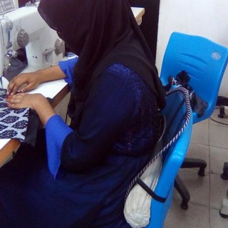
Activity B: Individually or in groups, compare & contrast the photographs below.
From a human factors /ergonomic perspective, consider:
the seating
the workstation
the posture of the workers
Are there any improvements you could suggest?
E
A
B
C
D
Notes:
Trainer:
Activity: Online discussion/or Classroom-based group work activity.
Trainees to consider the photographs A-E.
Observations:
A - Decent chairs with adjustable heights; back-rests; good working height; foot-rest etc. Also ceiling fans; spacing adequate although fluorescent lighting could affect eyes.
B - Hard wooden bench/sharp edges; no back-support; awkward workstation; stooping working posture etc. Comfort issue.
C - Again, hard wooden bench/sharp edges; no back-support; awkward workstation with little space; stooping working posture etc. Comfort issue.
D - Plastic seat with back-rest and cushion; probably able to adjust height - working posture could be improved if height can be adjusted.
E - Office/IT worker – soft cushioned adjustable chair; decent working height and viewing position; not much space and ambient heat from screen/computers could be an issue; probably noise issue.
Ask about any other suggestions to improve situation.
What kid of MSD or potential ill-health issues are possible?

Slide 30
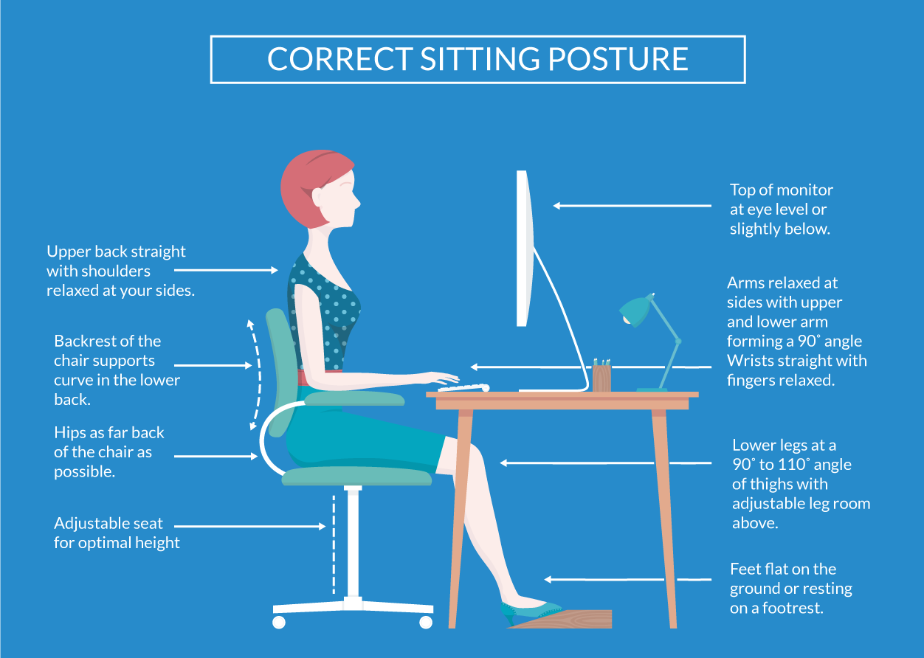
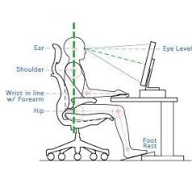
What good looks like
Notes:
Trainer:
Example of good balance between individual, workstation & job design.
This ergonomic approach would be supported by a Display Screen Equipment/Workstation Risk Assessment and would possibly be supported by a ‘wrist-rest’ to guard against RSI and carpel tunnel syndrome.

Slide 31
Accident reports
Failure to consider human factors
What happened?
Technical myopia (or short-sightedness)
Who to?
But not why?
When?
How it happened

Slide 32
But it’s not as simple as we think..
‘This accident was the result of human error’
‘…..pilot error’
Error or rule-breaking put down to: - ‘Lack of competence’ - ‘Poor supervision’ - ‘Not paying attention’ - ‘…a momentary lapse of concentration’
But it’s much more complicated than that in reality!
-----------------------------------
“To say accidents are due to human failing is like saying falls are due to gravity. It is true but it does not help us prevent them” (Trevor Kletz)
----------------------------------
“We must accept human error as inevitable – and design around that fact.” (Donald Berwick)

Slide 33
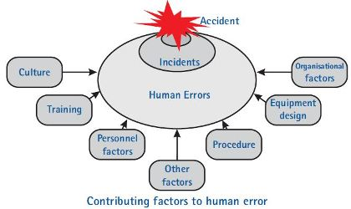
Human failure taxonomy (classifying our failures)
Human failures
Intended actions
Unintended actions
Violation - Intended consequences
Errors - Unintended consequences
Mistakes
Lapses
Slips
When the person decided to act without complying with a known rule or procedure
When the person does what they meant to, but should have done something else
When the person forgets to do something
When the person does something, but not what they meant to do
Notes:
Trainer: This are useful diagrams which acts as a mid-point summary and provide a framework to help give structure to the chaos of human error…
Highlight/explain: Errors E.g.
Slip
When a person does something, but not what they meant to do
Lapse
When a person forgets to do something
Both are unintended actions with unintended consequences
Briefly, cover the different pathways stressing that in the ‘cold light of day’ or in hindsight we can develop a ‘route cause analysis’ as to how accidents happen.
But often the ‘human dynamic’ is the most random to try and decipher!

Slide 34
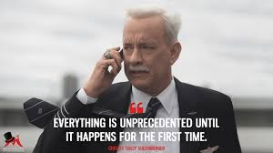
Example slip – Emirates EK407
Emirates Flight EK407
Pre-flight take off calculations were based on an incorrect take off weight (262M/t rather than 362M/t)
This weight was entered into take off performance software on separate laptop
Captain noticed something was wrong at the end of the runway, took manual control and selected maximum thrust...

Slide 35
Example slip – Emirates EK407
Captain had flown 99 hours in last month (1 hour below maximum allowed)
After the accident, Captain and First Office were asked to resign by Emirates and did so.
Had slept for 3.5 hours in 24-hour period prior to flight (shift rotas)
ATSB investigation revealed:
Excessively complex system for calculating take off speed (manual transfer of information from 2 automated systems)
No automated failsafe
Notes:
Trainer:
Not all mistake are deliberate human error – sometimes the reasons for errors are designed in to the system and it is only inevitable that at sometime some one will make a mistake which leads to an accident. Hence, the need for us to review repeated near miss or minor accidents to eliminate potential system flaws or human errors from becoming serious accidents.

Slide 36
Mistakes
Because the action is intended, mistakes are much harder to detect at the individual level
People believe what they are doing is right and often dismiss evidence to the contrary
Bias
Tunnel vision

Slide 37
Violations (1)
The Assistant Boson who was asleep rather than checking the bow doors were closed on the Herald of Free Enterprise
The technicians who knowingly maintained the Chernobyl reactor in an unsafe state to allow a safety study to be conducted
What violations exist in your factory?

Slide 38
Violations (2)
Note that we all integrate rule violation into our day to day lives so the identification of a violation should not be regarded as a precursor to discipline an individual
Indeed, we often tend to like those who break the rules!

Slide 39
Violations (2)
Types of violations
The key to the effective analysis of violations is to understand why
Routine
Exceptional
Acts of sabotage
What existed before or logically was expected to precedes another?
What behaviour was observed?
What consequences resulted?

Slide 40
Performance Influencing Factors
Defined as ‘the characteristics of the job, the individual and the organization that influence behaviour’
Considered during behavioural analysis, often at the end of the process
Very broad topic including a range of factors e.g. fatigue, group effects, design of equipment, mental wellbeing, task knowledge/complexity
Often have a critical role in error causation but equally often overlooked (e.g. fatigue EK407)

Slide 41
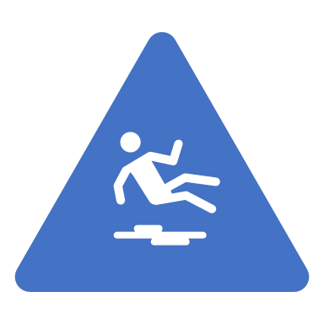
Why bother with any of it?
Each failure type has a different set of solutions designed to prevent their reoccurrence.
Slip/Lapse
NOT training
Hardware solutions
Cross checks
PIFs
Error
Training e.g. scenarios
Group support
Challenge
Violations
Behaviour modification
Culture improvement

Slide 42
A final thought
The most powerful influence on human behaviour is outcome
Therefore managing human failure requires a high degree of corporate honesty:
What behaviour is really rewarded?
Are we willing to look at organisational factors, especially when we see rule breaking?
Are we willing to make the investments that are likely to prevent reoccurrence?
Are we willing to strive for objectivity and pragmatism?

Slide 43
What to remember
Human behaviour can be predicted with reasonable accuracy
Correctly integrating HF into your accident investigation process will reap rewards
Separating error, mistake and violation represents a highly valuable first step
The best way to learn about Human Factors & Ergonomics is to do it, practice it & do it again!

