Slide 1
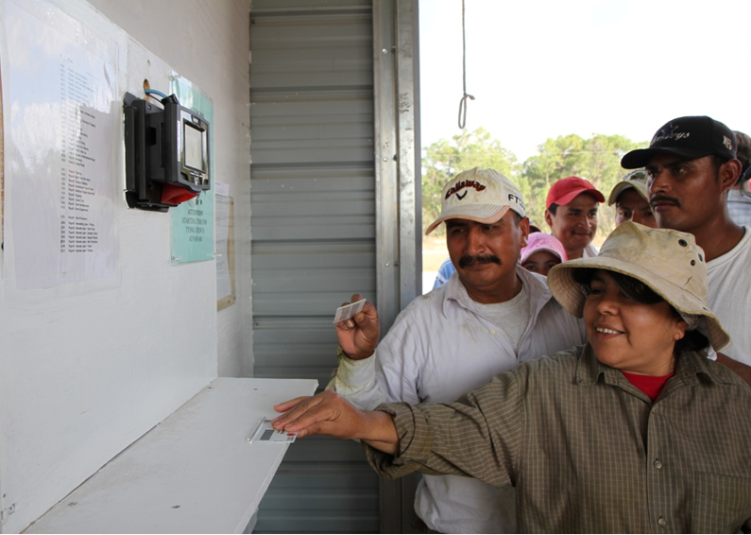
Revision of the ETI Base Code clause on working hours
Summary guidelines
Photo courtesy of Fair Food Programme
www.fairfoodstandards.org

Slide 2
Timescale - 2014
1st April
April-Sept
1st September
1st December
Revised wording launched
Companies prepare for implementation
Companies start implementing revised wording
All social audits use the revised wording

Slide 3
Why is managing working hours important?
Research has shown that working more than 48 hours per week:
Is bad for workers’ health
Reduces productivity and quality of work
Causes stress
Makes caring for children and dependents difficult

Slide 4
Why we revised our working hours clause
To enable employers to better understand and manage working hours
To allow more flexibility in the number of overtime hours allowed, without allowing excessive working hours overall
To reduce confusion over the use of certain terms

Slide 5
The new wording
6.1 Working hours must comply with national laws, collective agreements, and the provisions of 6.2 to 6.6 below, whichever affords the greater protection for workers. 6.2 to 6.6 are based on international labour standards.
6.2 Working hours, excluding overtime, shall be defined by contract, and shall not exceed 48 hours per week*
6.3 All overtime shall be voluntary. Overtime shall be used responsibly, taking into account all the following: the extent, frequency and hours worked by individual workers and the workforce as a whole. It shall not be used to replace regular employment. Overtime shall always be compensated at a premium rate, which is recommended to be not less than 125% of the regular rate of pay.
6.4 The total hours worked in any 7 day period shall not exceed 60 hours, except where covered by clause 6.5 below.
6.5 Working hours may exceed 60 hours in any 7 day period only in exceptional circumstances where all of the following are met:
this is allowed by national law;
this is allowed by a collective agreement freely negotiated with a workers’ organisation representing a significant portion of the workforce;
appropriate safeguards are taken to protect the workers’ health and safety; and
the employer can demonstrate that exceptional circumstances apply such as unexpected production peaks, accidents or emergencies.
6.6 Workers shall be provided with at least one day off in every 7 day period or, where allowed by national law, 2 days off in every 14 day period.

Slide 6
The new wording
Footnote:
“International standards recommend the progressive reduction of normal hours of work, when appropriate, to 40 hours per week, without any reduction in workers’ wages as hours are reduced.”
This is not a requirement of the Base Code, but employers are encouraged to work towards this

Slide 7
What are the key changes?
Overtime shall be:
“used responsibly”
voluntary and “taking into account all the following: the extent, frequency and hours worked by individual workers and the workforce as a whole”
“not...used to replace regular employment”
“compensated at a rate recommended to be not less than 125% of the regular rate of pay”

Slide 8
What are the key changes?
“The total hours worked in any seven day period shall not exceed 60 hours”
Old version
48 hours
12 hours
Standard
Overtime
(ie overtime may not be more than12 hours regardless of standard hours worked)
New version
60 hours in total
Standard + Overtime
(ie overtime may be more than12 hours if standard hours are less than 48)

Slide 9
What are the key changes?
In some exceptional circumstances hours may exceed 60 – but only if all four of the following criteria are met:
this is allowed by national law;
this is allowed by a collective agreement freely negotiated with a workers’ organisation representing a significant portion of the workforce;
appropriate safeguards are taken to protect the workers’ health and safety; and
the employer can demonstrate that exceptional circumstances apply such as unexpected production peaks, accidents or emergencies.

Slide 10
What should I do now?
Discuss the changes with your workers’ representatives and re-negotiate collective agreements as necessary
Review and revise your Human Resources policies to meet updated ETI wording
Review and revise the processes you use to manage working hours (such as production planning to avoid long hours)

Slide 11
What should I do now?
Document your updates so that they can be communicated and monitored
Clearly, accurately and regularly communicate your updates to your customers/suppliers, workers and their representatives
Regularly monitor updated working hours policies and processes to make sure they are working
Make adjustments if they are not working

Slide 12
What should I do now?
NB If you use homeworkers make sure that they too are covered by your revised processes to meet the new requirements.

Slide 13
Tips to reduce working hours
Set reasonable production targets and schedules based on realistic labour efficiency rates
Closely coordinate HR plans and production targets
Continually upgrade workers’ skills through training, mentoring and coaching
Improve communication with supervisors and line managers and between line managers and workers
Form a team of trade union members/worker representatives to supervise changes and provide ongoing feedback

Slide 14
Where can I get more information?
Ethical Trading Initiative: www.ethicaltrade.org/eti-base-code/working-hours
SEDEX helpdesk (if you are a member): www.sedexglobal.com/about-sedex/contact-us
Local trade unions
Your country’s ministry of labour or equivalent
Your customers - especially if they are ETI members

Slide 15
Thank you
The Ethical Trading Initiative (ETI) is a leading alliance of companies, trade unions and NGOs that promotes respect for workers’ rights around the globe.
Our vision is a world where all workers are free from exploitation and discrimination, and enjoy conditions of freedom, security and equity.
Ethical Trading Initiative 8 Coldbath Square London EC1R 5HL UK
T +44 (0) 20 7841 4350 F +44 (0) 20 7833 1569 eti@eti.org.uk

